Slide 1
VERIFI: A Software Tool for Tracking Industrial Utility Data
Kristina Armstrong
Christopher Price
Paulomi Nandy
Thomas Wenning
Nate Roberts

Slide 2
DOE Industrial Software Tools
Designed to help energy and sustainability teams identify savings opportunities in their operational energy usage and emissions
Energy Systems
MEASUR
Electrification for Decarbonization
Compressed Air Scoping Tool
Energy Management
VERIFI
50001 Ready Navigator
Energy Footprint Tool
Plant Energy Profiler
Implementation Guidance Toolkit
Carbon, Water, & Waste
Plant Water Profiler
Plant Carbon Footprint & Decarbonization Assessment Tool
Carbon Emissions Calculator
Waste Stream Energy Content

Slide 3
VERIFI is an Integrated Energy Tracking Tool
Free to Use
OS Agnostic
Web & App - Windows, Mac, Linux
International Useability
No limits on where VERIFI can be downloaded or accessed
Google Translate available for web version
Unit system flexibility: Make an assessment in metric or U.S. units and switch to the other
Data Privacy
Data is stored on *YOUR* device
No data you entered is sent to us unless you send it to us directly
Data related to use (where you click, etc.) is collected via Google Analytics to improve the tool
Automatic Updates

Slide 4
How VERIFI can help Energy Managers
Normalize manufacturing energy use and generation
Identify potential savings
Help reduce losses in key manufacturing systems (~4.7 QBTU as of 2018)
Identify high performing and low performing facilities with biggest impact on company-level performance
Simple analysis tools for absolute, intensity, and regression-based targets

Slide 5
How VERIFI can help Sustainability Teams
Track direct stationary (Scope 1) and indirect (Scope 2) emissions
Including Fugitive/Process and Mobile Emissions!
Automatic EPA eGRID subregion emission factors based on ZIP code
Including residual mix for market-based
Emission factors for common fuels
Custom emission factors for electricity or fuels

Slide 6
VERIFI Key Features
Tracking Utility Data
Track energy usage, utility costs, and GHG emissions
Monitor facility and company level progress on energy and GHG emission reduction goals
Data Visualization
Easily identify unusual usage or high energy costs
Determine correlation between energy use and relevant variables such as production or weather
Analysis
Automatic weather data based on facility location
Simple regression modeling to track energy intensity
Carbon and GHG emission performance analysis
Reporting
Automatically create annual reports for the Better Plants and Climate Challenge programs
Create automatic performance reports

Slide 7
VERIFI Tool Highlights
Company and facility-level energy analysis tool
Utility bill tracking and visualization tool
Automatic calendarization
Annual costs, energy use, carbon emissions, and water use
Helps energy management teams track and understand their energy use and emissions output
Available for “Beta” testing
Replacement for legacy EnPI tool
Incorporate other DOE facility-level tools into a single program
Regular updates for development and to improve functionality
Updates will not affect data in already in the tool

Slide 8
How to Find VERIFI
Beta version released in early 2023
Updates will occur often
Notification of updates if connected to the internet
Please report bugs to: verifi-help@ornl.gov
Download from ORNL GitHub
Uninstalling will delete your data!
If using online:
Webpage may need a “hard refresh” to see latest update
Cleaning your cache will delete your data!
Download at https://ornl-amo.github.io/
Visit https://verifi.ornl.gov/ in your web browser
Type “ORNL VERIFI” in your web search

Slide 9
Setup Overview
Getting data into the tool and visualizing your usage.

Slide 10
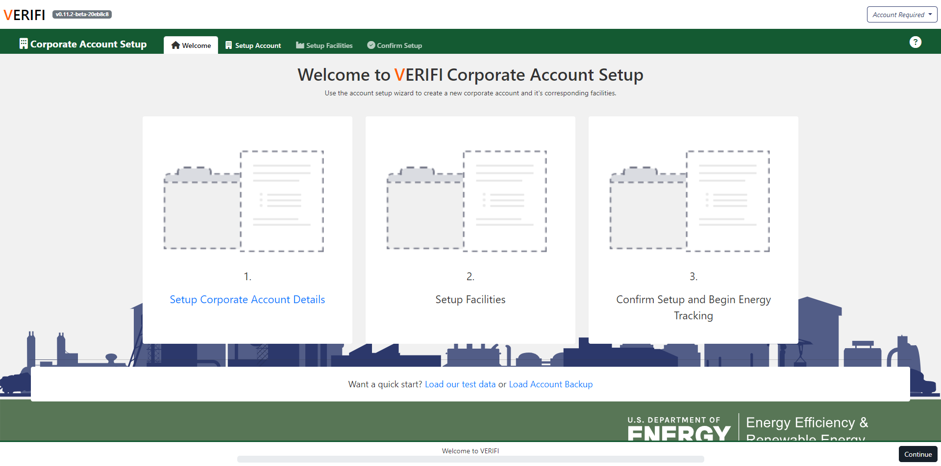
First Time Starting VERIFI
Create Account
Load sample data
Load Backup data
Create your own Company level account

Slide 11
VERIFI Account Setup
Enter Company Information: (Sets default for facilities)
Point of contact
ZIP Code
NAICS Code
Enter Data Collection Information:
Units
eGRID Subregion
Enter Goals Information:
Energy, carbon, water, etc.
Calendar or fiscal year

Slide 12
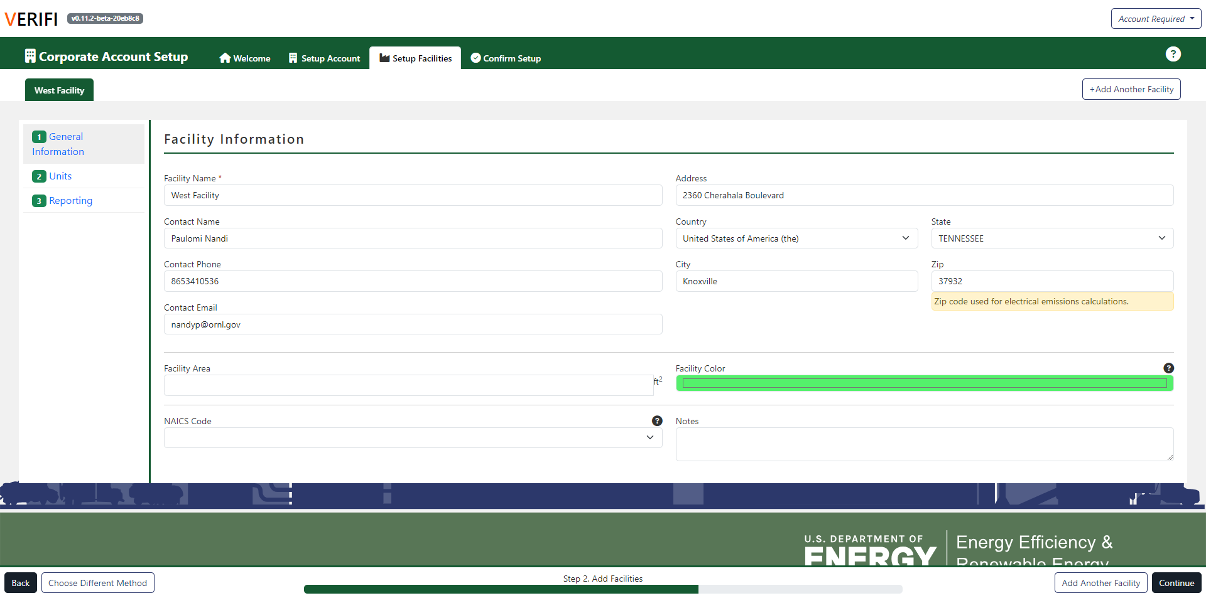
VERIFI Facility Setup
Inherits traits from company setup
Each facility can have different settings for:
Points of contact
Collection units
Reporting goals
Color code facilities for easy navigation
Create facilities for all sites in your portfolio
West
South
East
North

Slide 13
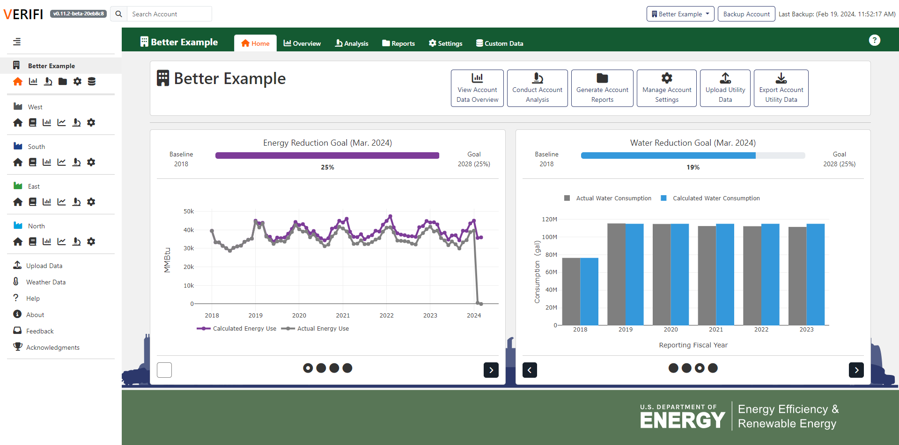
Basic VERIFI Layout
Manage Accounts
Backup Account
Top Panel
Use tabs to navigate steps and menus
Find help text for each page of the tool
Side Panel
View all your facilities
Switch between home, utility data, data visualization, analysis, and settings views
Data upload, weather data, help, feedback, and acknowledgements

Slide 14
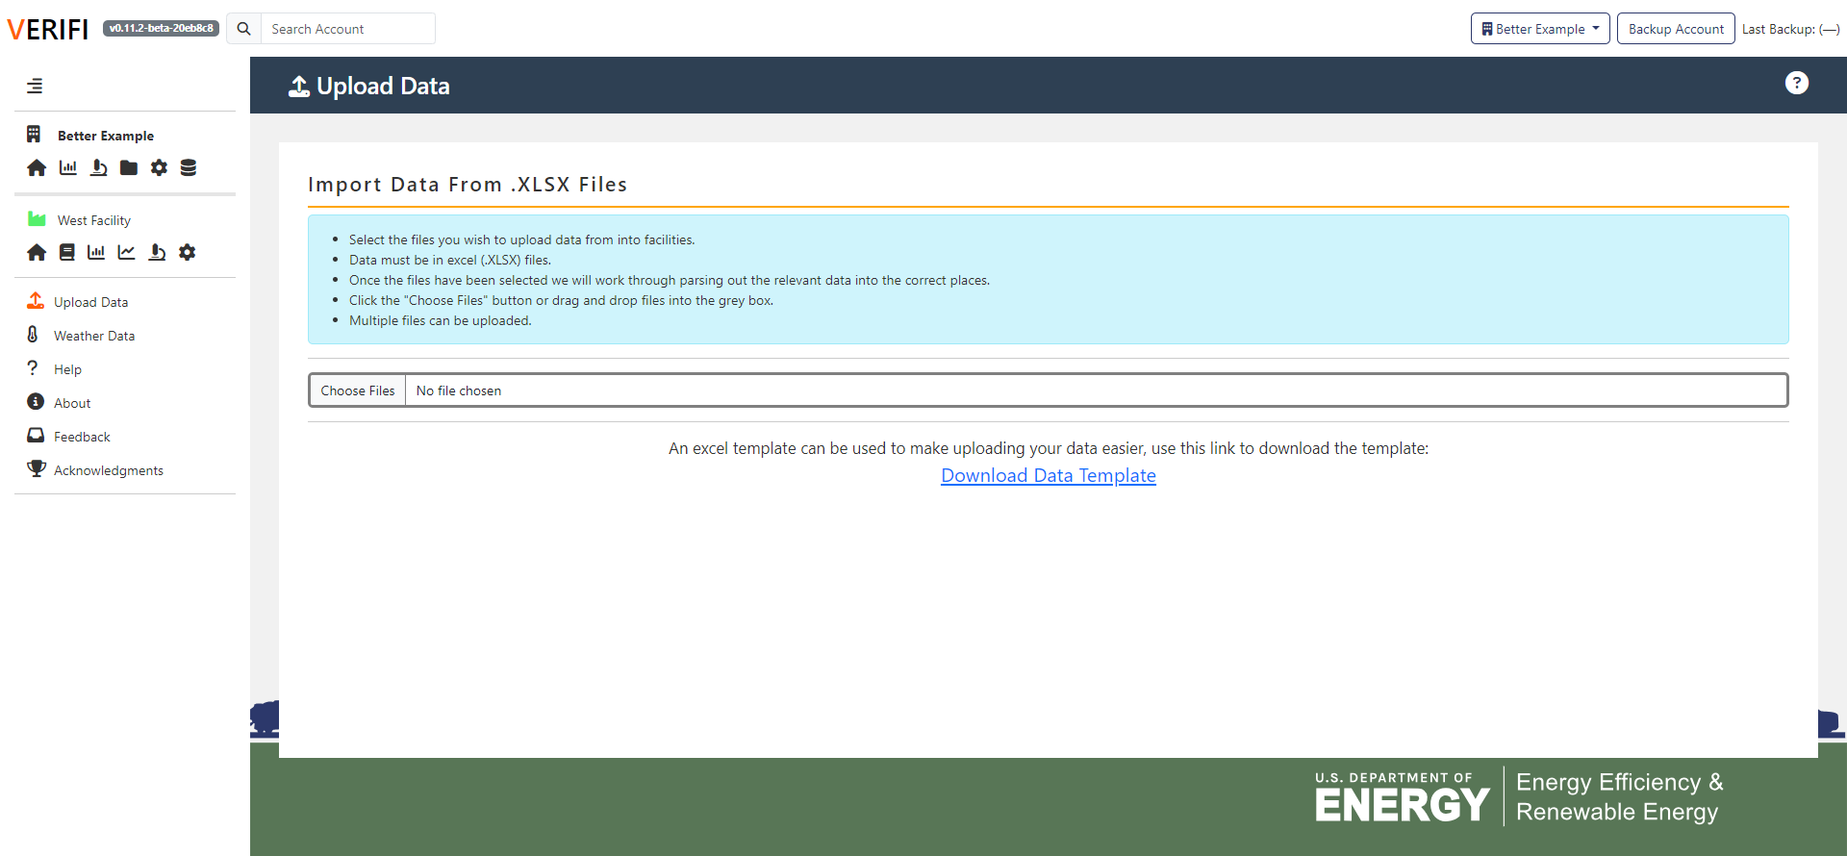
Importing Data into VERIFI
Select “Upload Data” from side panel
Select “Choose File” to browse for upload file or drag and drop.
Follow prompts from VERIFI to complete the data upload.

Slide 15
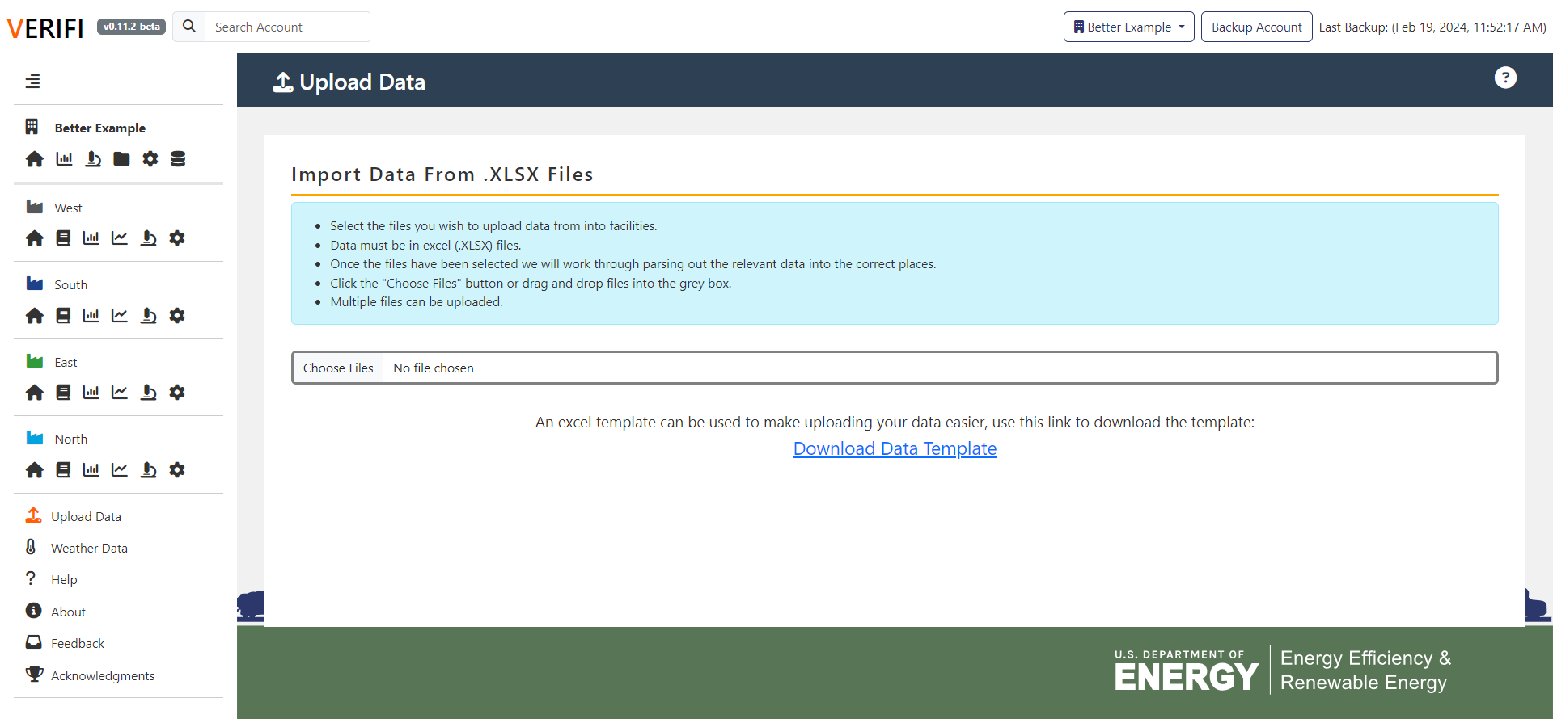
Importing Data into VERIFI – Excel Template
Use the VERIFI Excel template to set up multiple facilities, meters, and emissions sources… All at once!
Select “Upload Data” and then download blank template
Follow tabs to collect usage and predictor data

Slide 16
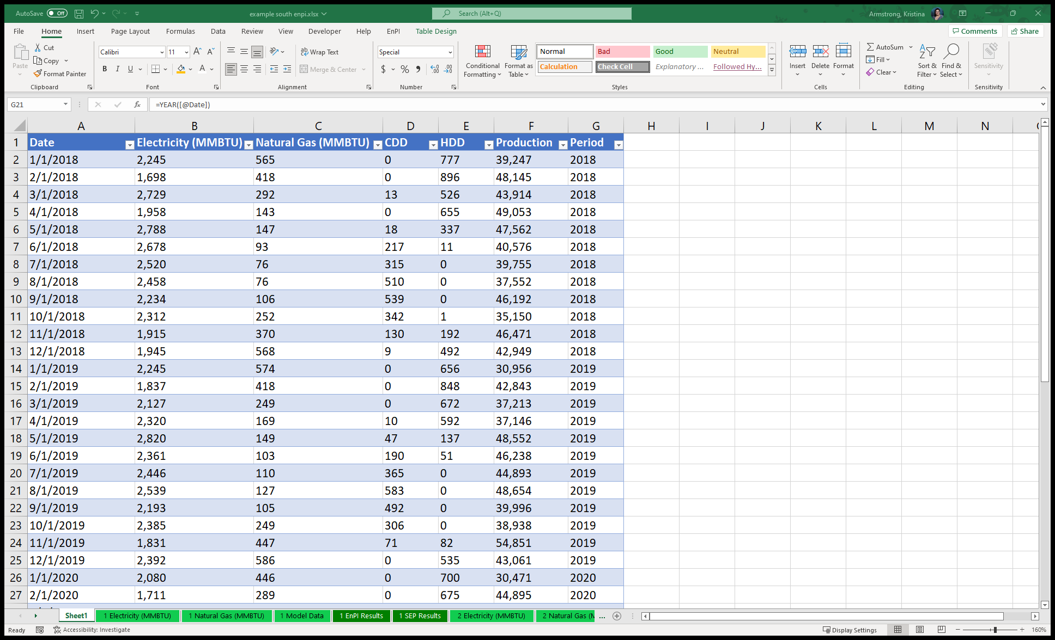
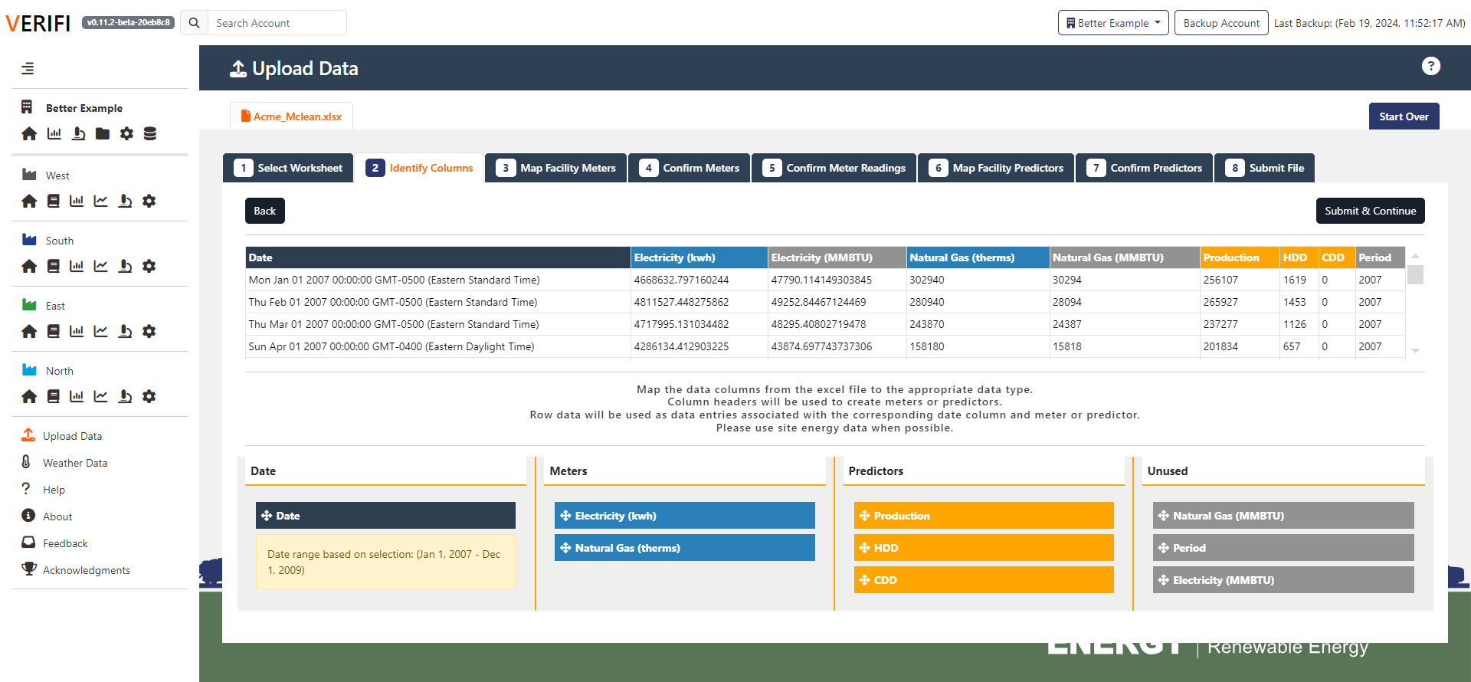
Importing Data into VERIFI – Data Wizard
Use the data import wizard to enter legacy EnPI files or similar column formatted data
Assign columns a data type
Date, meter, predictor
Assign meters to facilities
Assign predictors to facilities
Repeat this process for all facilities in portfolio

Slide 17
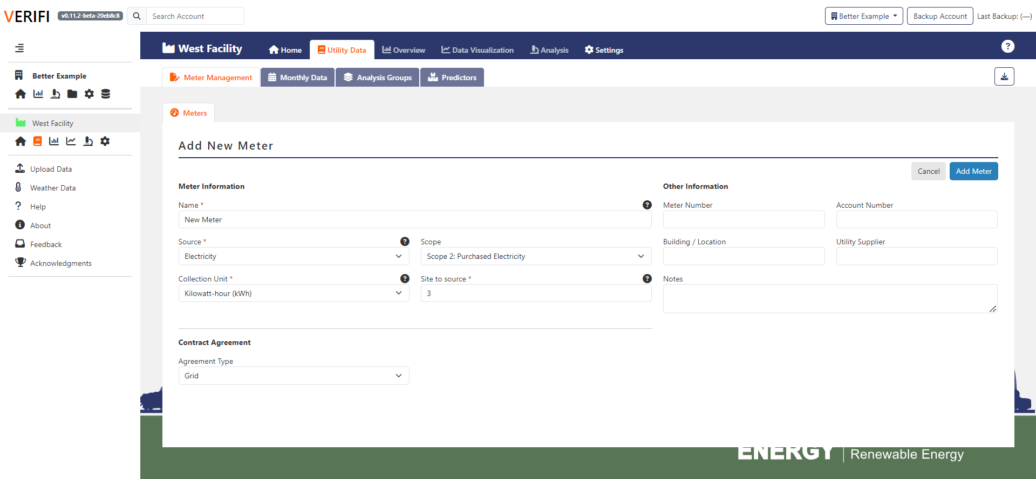
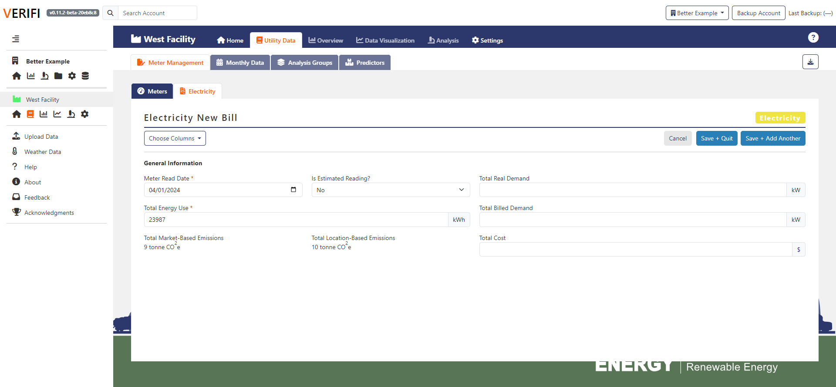
Importing Data into VERIFI – Manual Entry
Create meters individually
For each meter, add meter readings
Includes meter read date
Consumption/emissions
Costs
Works best for updating VERIFI accounts that already have data imported

Slide 18
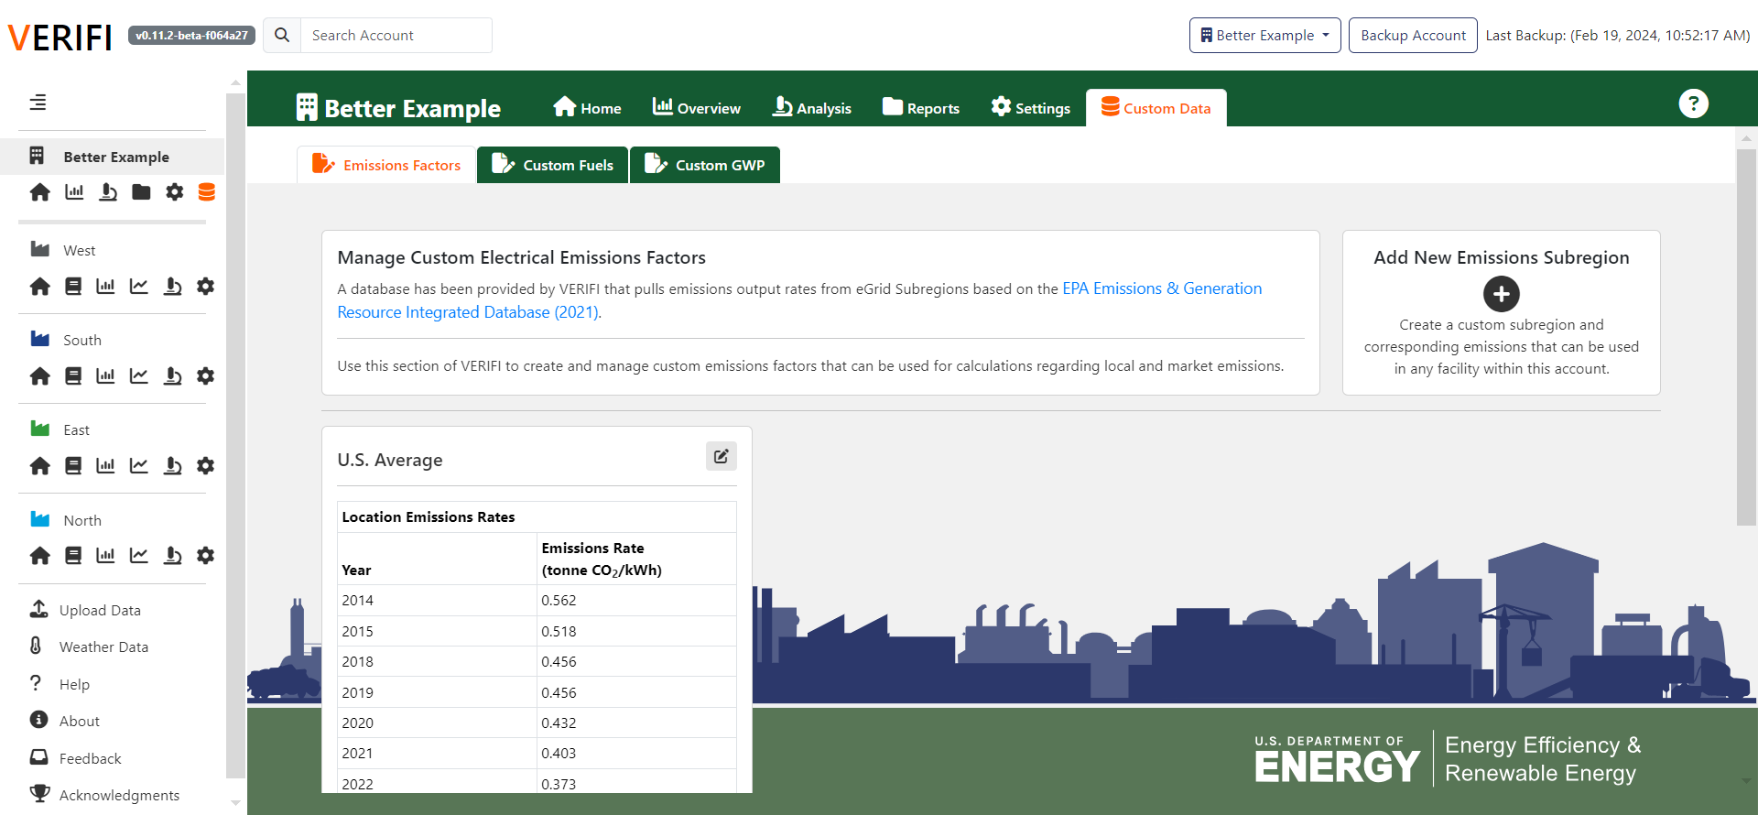
Adding Custom Emission Factors
VERIFI has in-built emission factor databases for:
Scope 1
Stationary (natural gas, propane, fuel oils, etc.)
Mobile (gasoline, diesel, etc.)
Fugitive (common refrigerants, etc.)
Scope 2
Location-based (eGrid)
Market-based (Green-E)
Can create factors for custom fuels and subregions:
Select “Custom Data” from the side panel
Custom Electricity Region
Custom Stationary/Mobile
Custom Fugitive/Process

Slide 19
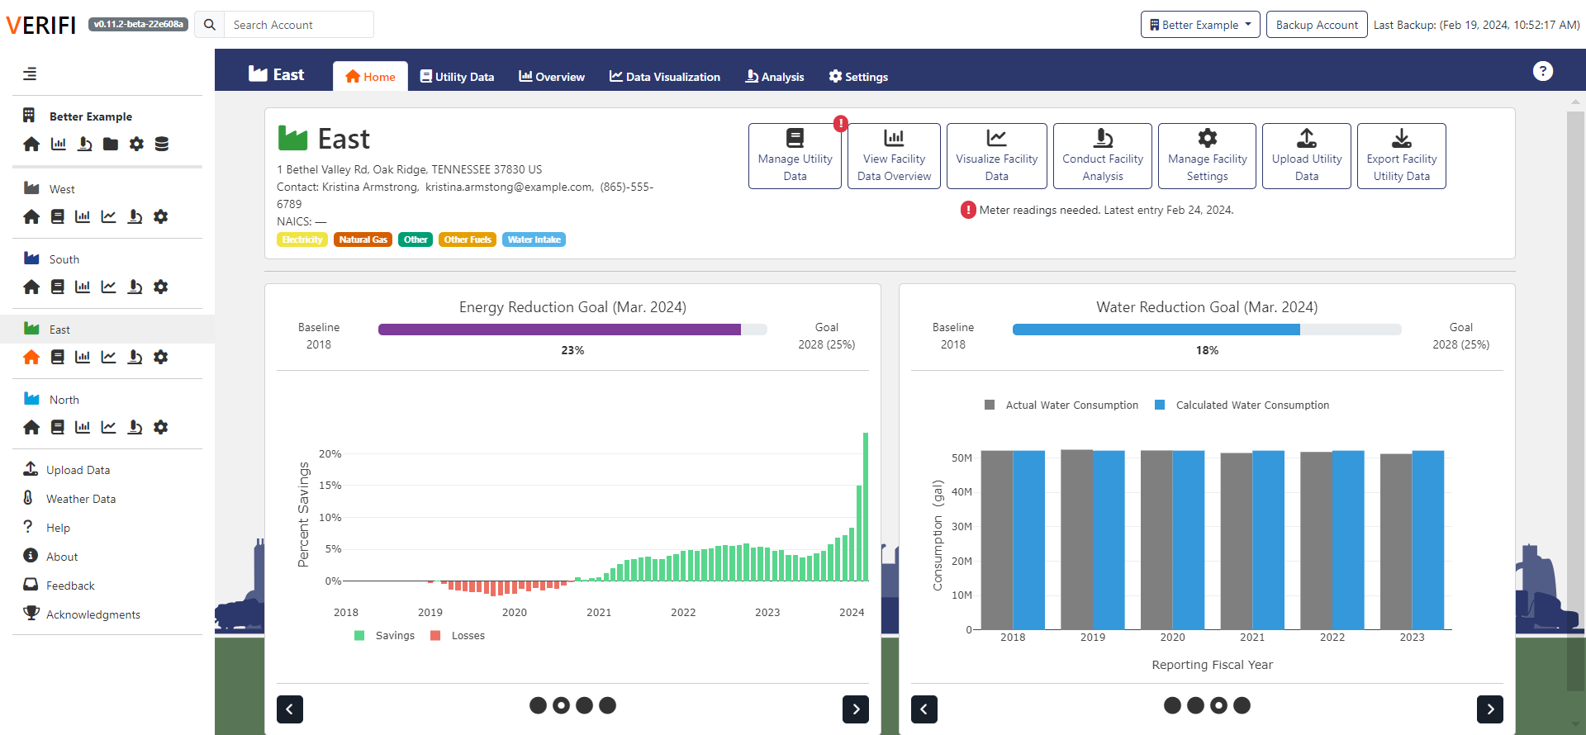
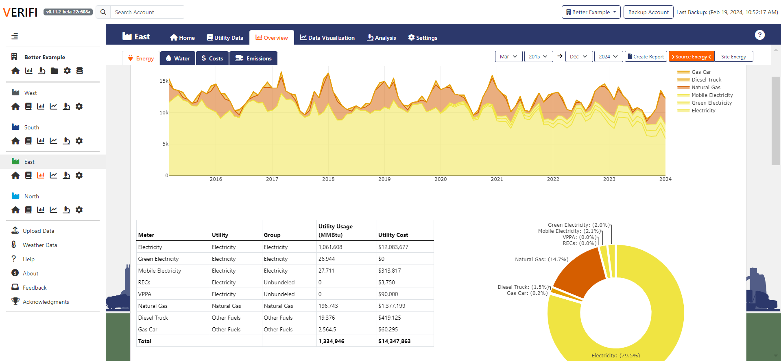
Explore Facility Usage
Select “Facility Home” from the side panel.
Explore graphs and usage trends.
Select “Facility Overview” from the side Panel.
Explore graphs and usage trends for energy, water, cost, and emissions.

Slide 20
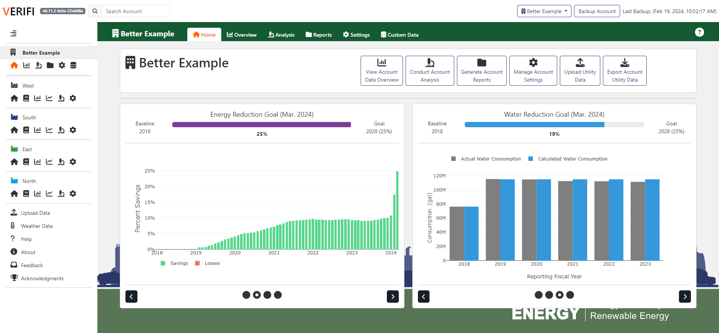
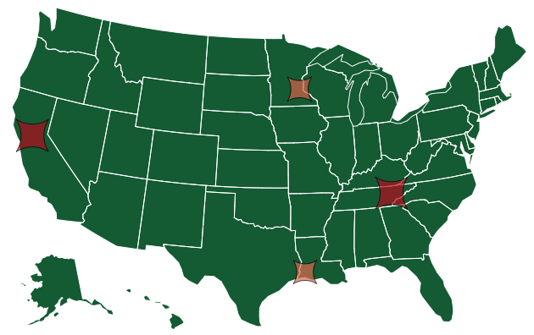
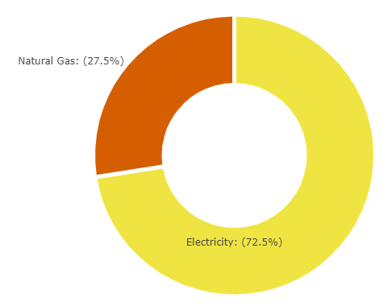
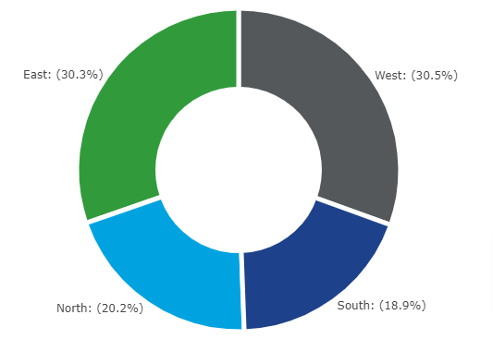
Explore Company Usage
Select “Company Home” from the side panel.
Select “Company Overview” from the side panel.
See breakdowns by facility, utility, and year.
See data on energy, water, cost, and emissions.

Slide 21
Analysis Overview
Performing analysis and generating reports.

Slide 22
What do I need to perform an analysis?
Before doing an analysis, you must have done the following:
Entered consumption data for energy, emissions, or water
Added production related predictors (widgets, hours, etc.)
Created custom GHG emission factors for your activities or energy purchasing (if needed)
After these initial steps, there are still a few things to do:
Calendarize your data to fix inconsistent billing periods
Group meters in similar areas, by process, etc.
Generate weather predictors
Explore data relationships between predictors and usage
Notes:
NOTES: Do not *have* to calendarize, but do have to choose how you will calendarize (yes, no, annual)
Don’t have to generate weather. Do not need weather & can import directly

Slide 23
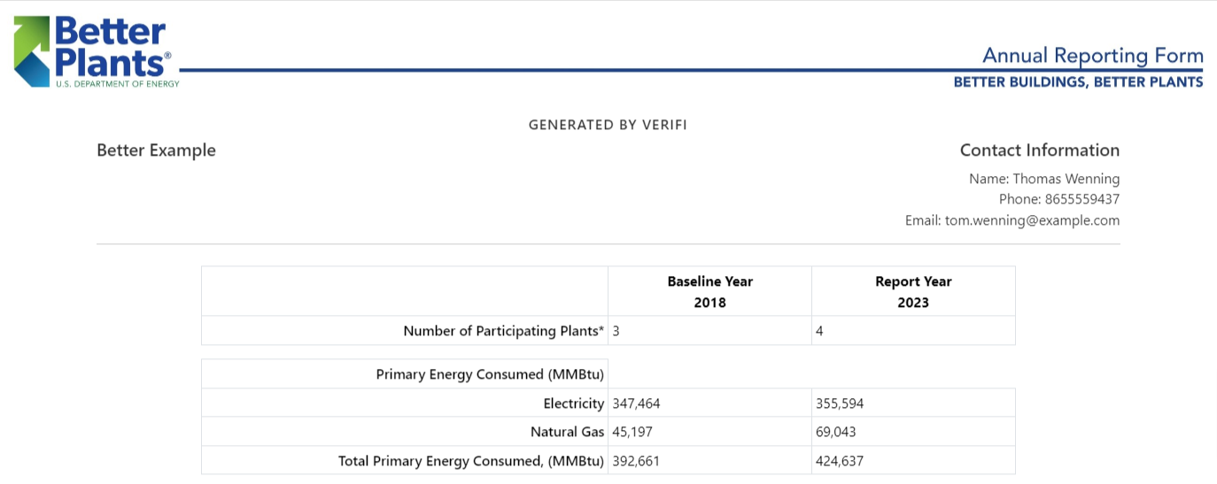
What kinds of analysis and reports can VERIFI do?
Reports are aggregates of data or analysis results for viewing in a concise matter
Some VERIFI reports…
Match formal reporting templates
Have been developed to help understand energy and emission performance
If you have ideas on reports that can be integrated into VERIFI let us know!
Types of Company-level Reports
Better Plants Energy & Water
Better Climate Challenge
Energy Performance
Data Overview
Types of Facility-level Reports
Analysis (Results & Regression Quality)
Data Overview

Slide 24
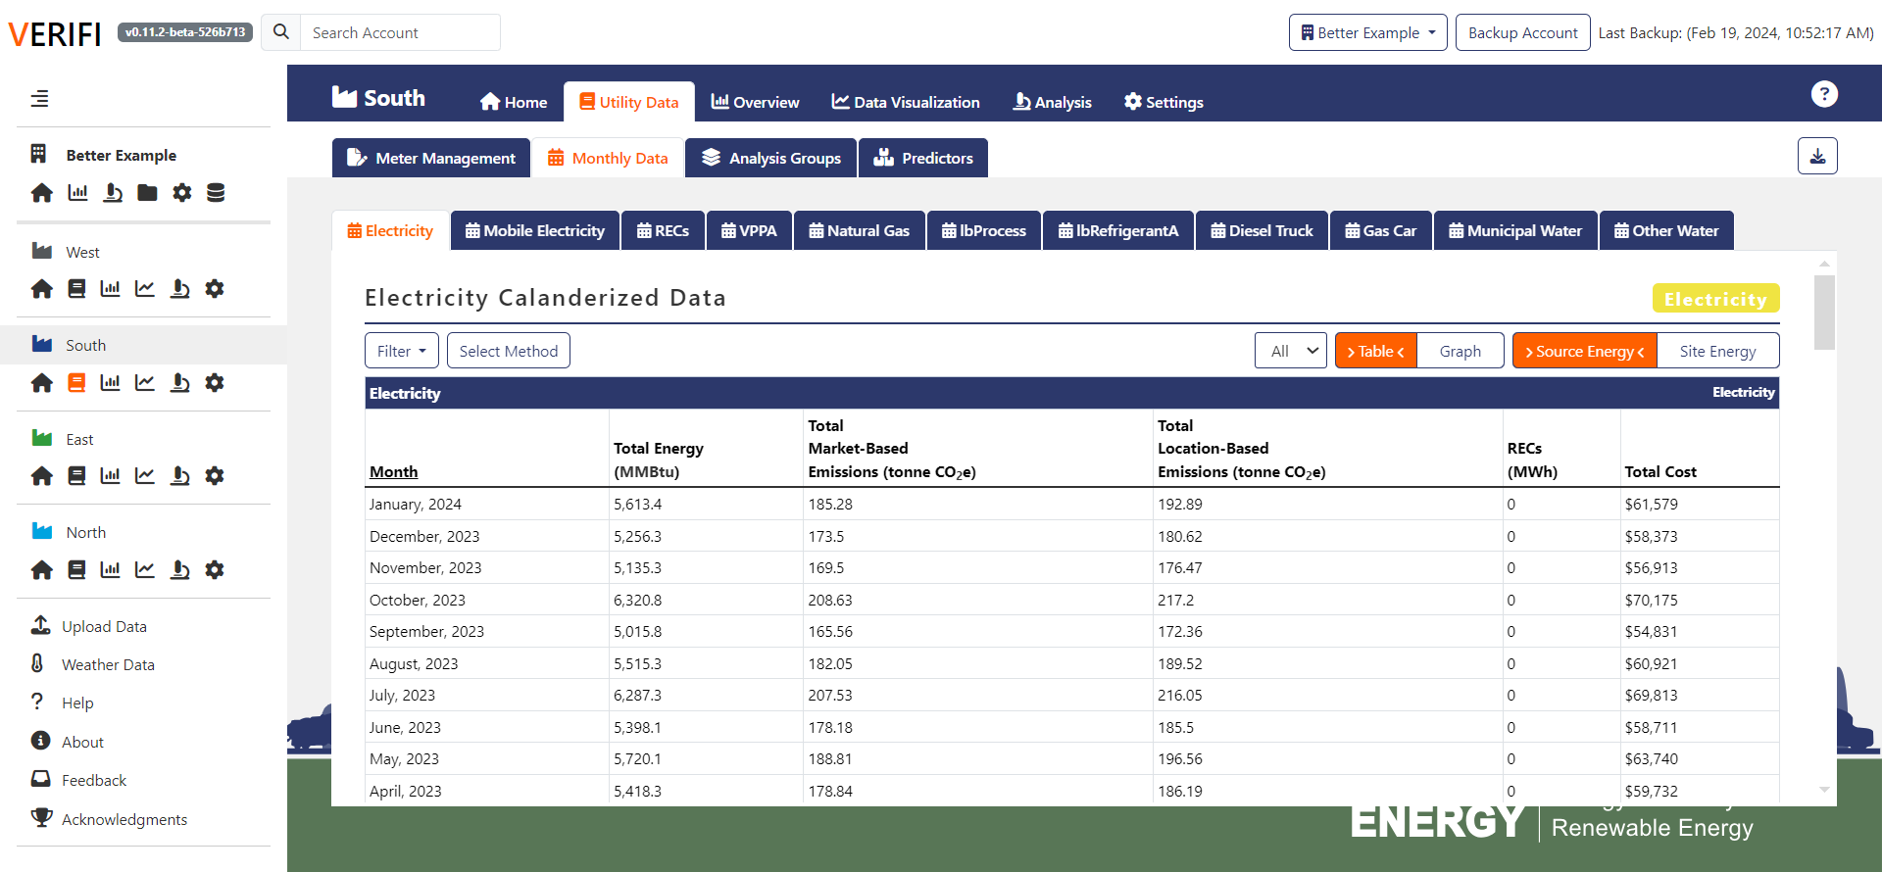
Calendarizing Data in VERIFI
Sometimes billing periods depend on when the utility reads the meter
Calendarization makes billing periods consistent between years
VERIFI can calendarize for you!
Select “Monthly Meter” from the second level tabs.
Select a meter and then click “Select Method”
Use dropdown to select method used to calendarize the data
Repeat for all meters that require calendarization

Slide 25
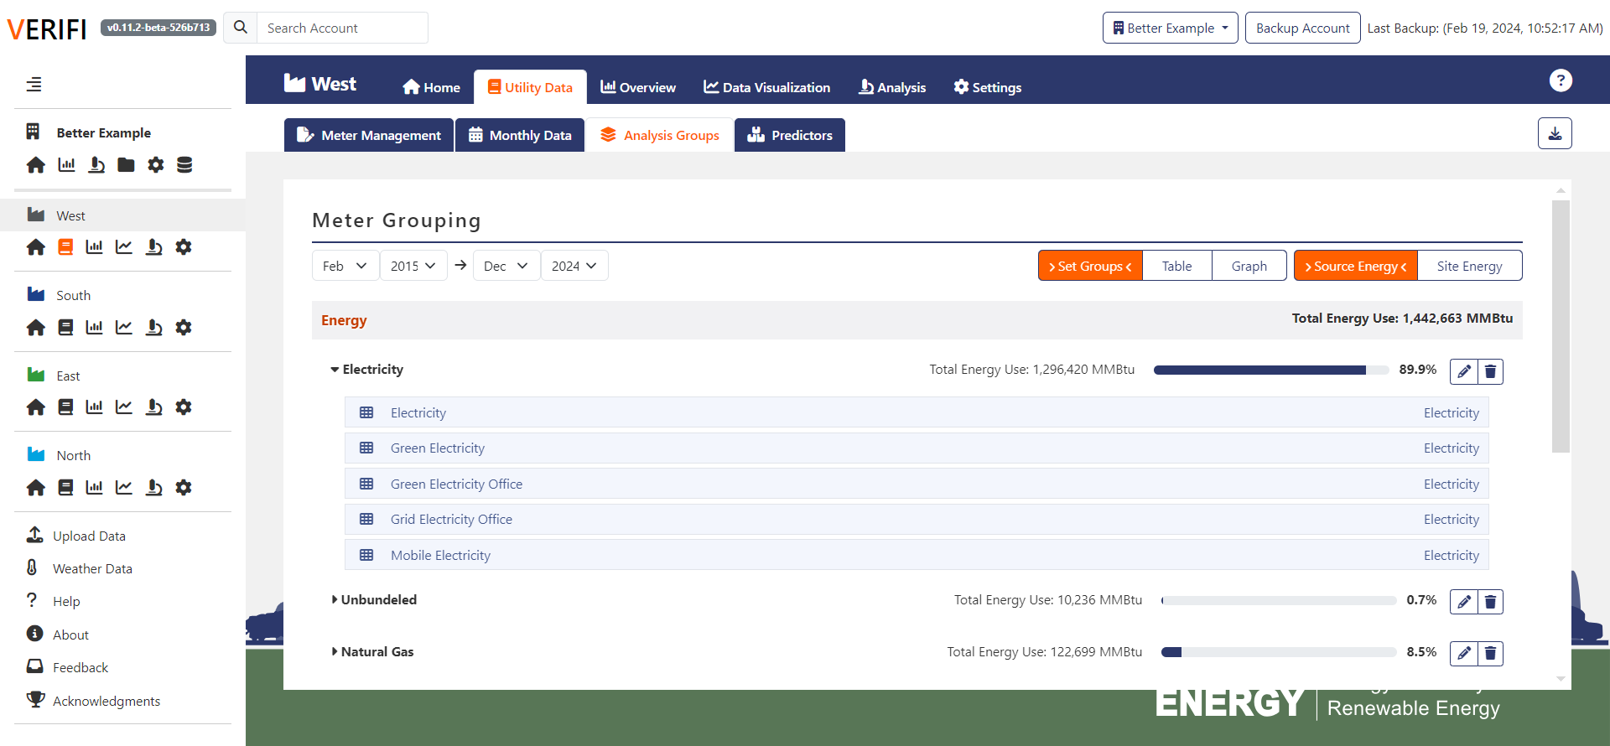
Grouping Meters for Analysis in VERIFI
Analysis Groups are collections of meters that are used for analysis
Group meters in ways that work for your analysis
Select “Meter Groupings” from the second level tabs.
Create new or edit existing groups based on meters
Click and drag meters into appropriate groups

Slide 26
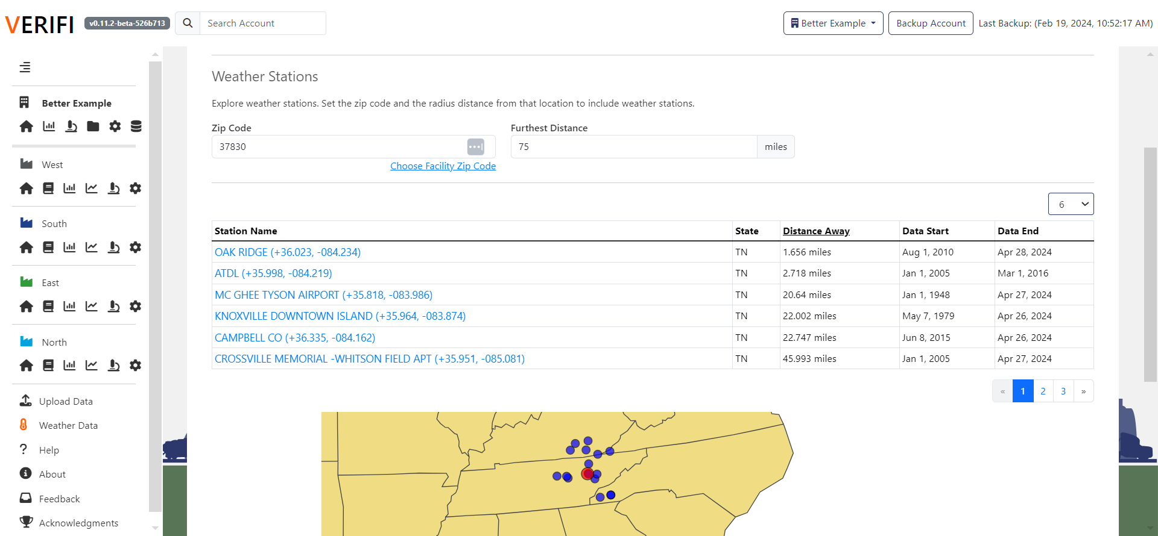
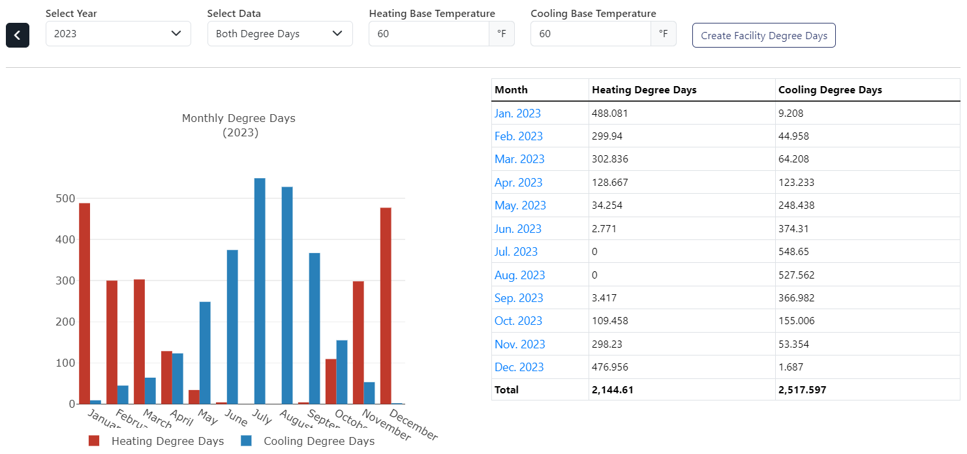
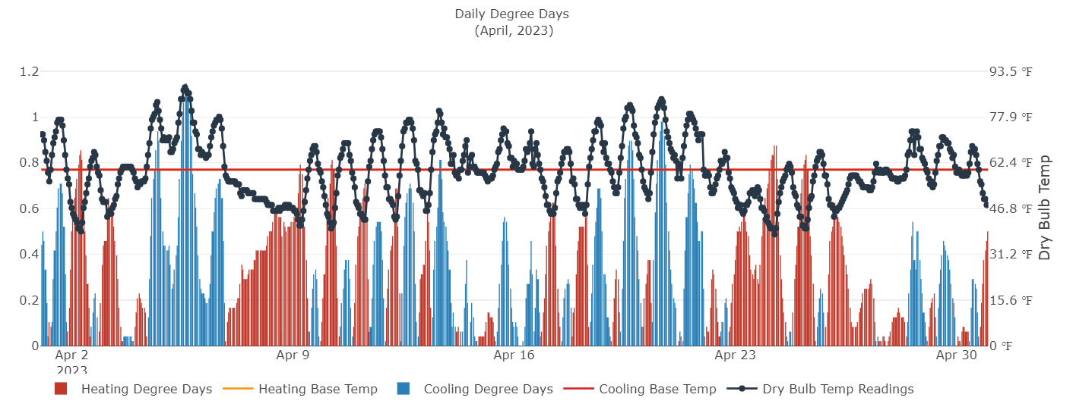
Automated Weather Data in VERIFI
Facility energy usage can be affected by the local climate
VERIFI can automatically generate weather data for your analysis
Select “Weather Data” from side bar
Enter ZIP code or select a facility and set a distance radius for weather stations
Select a station to view detailed weather data
Set balance temperatures, view data integrity, and assign data to a facility
2
3
4
1

Slide 27
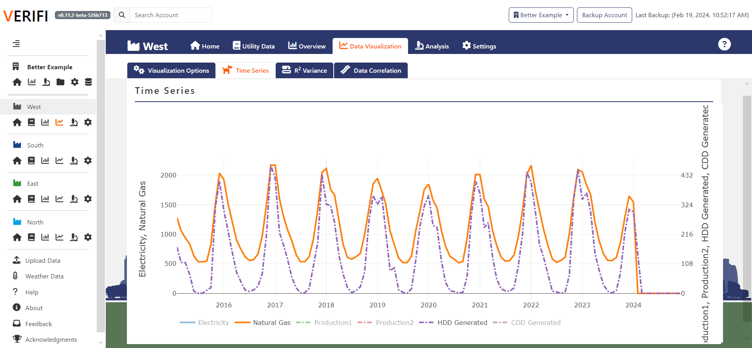
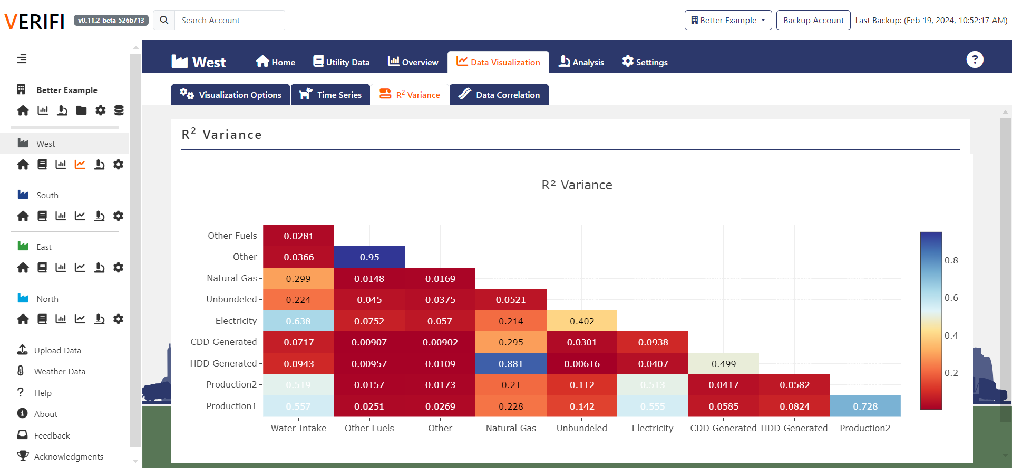
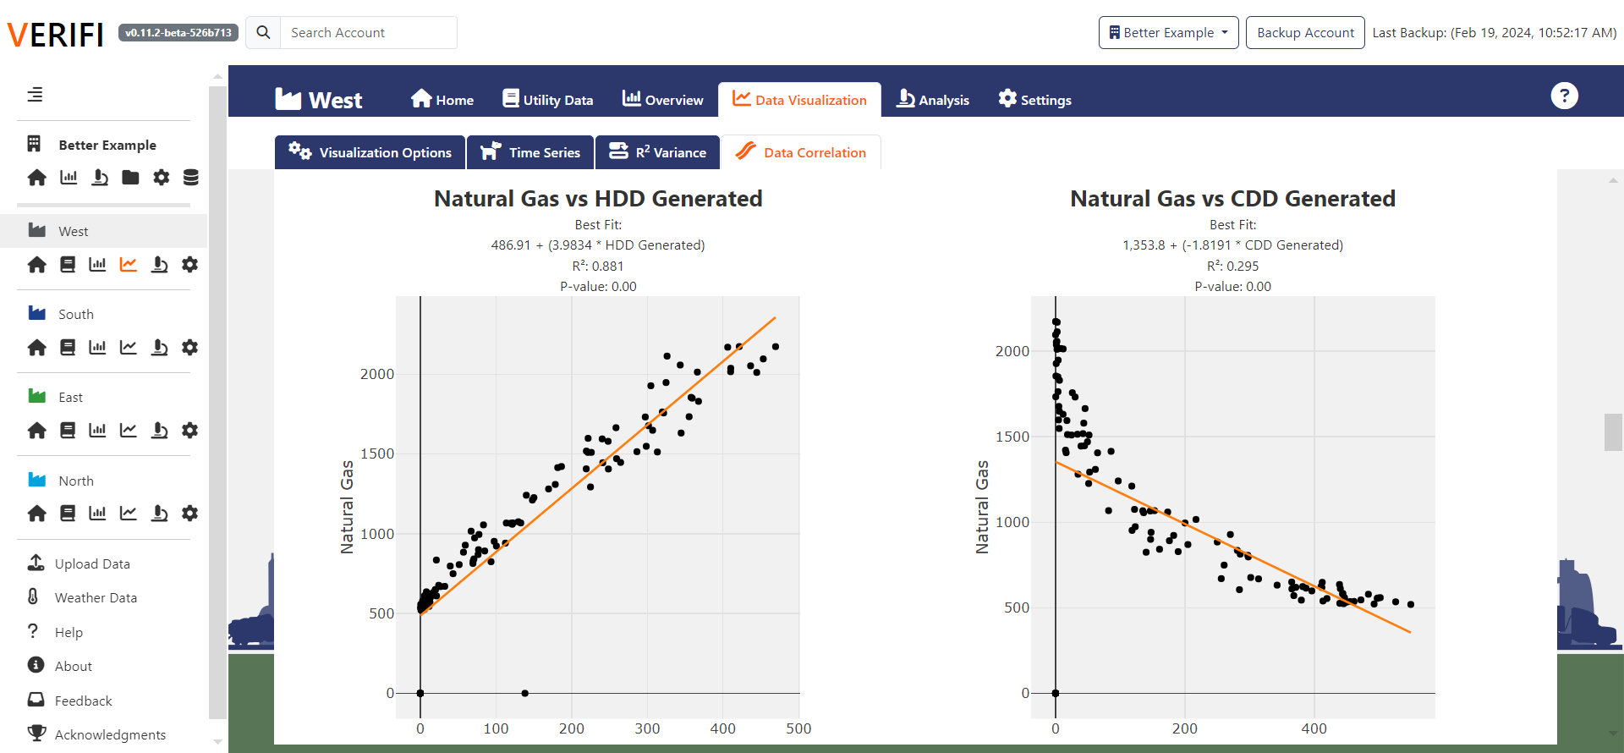
Visualizing Data in VERIFI
Use data visualizations to:
Identify trends
Find correlations to predictors
Prepare for regression analysis
View data by:
Time series
R² variance
Data correlation

Slide 28
What are facility-level analyses?
Facility-level analysis tools help you to:
Understand how energy and water efficient your facilities are
Normalize usage data
VERIFI can perform many types of analysis including:
Absolute
Intensity
Regression

Slide 29
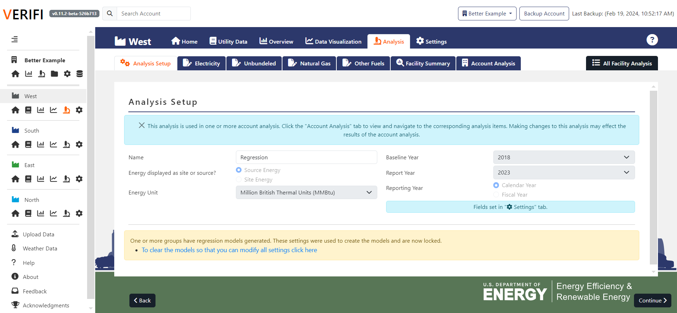
Completing a Facility-Level Analysis
Name your analysis and select the baseline year
1
Select the analysis type (e.g., absolute, intensity, regression)
2
3
IF A REGRESSION – Pick the best model for the facility analysis
Repeat for all groups!

Slide 30
Making Facility-Level Reports
Facility reports provide a quick overview of the analyses and data
VERIFI can make:
Analysis Report
Analysis Results
Regression Statistics (selected variables, R2, p-value, validation checks)
Data Overview Reports
Select a facility-level analysis to make an automated report

Slide 31
What are company-level analyses?
Roll-up Analysis:
Necessary for Better Plants energy and water reports
Choose which facility-level analyses to include
Calculate Company- level performance
Facility-level reports must have the same*:
Baseline year
Report year
*(Except for new facilities)

Slide 32
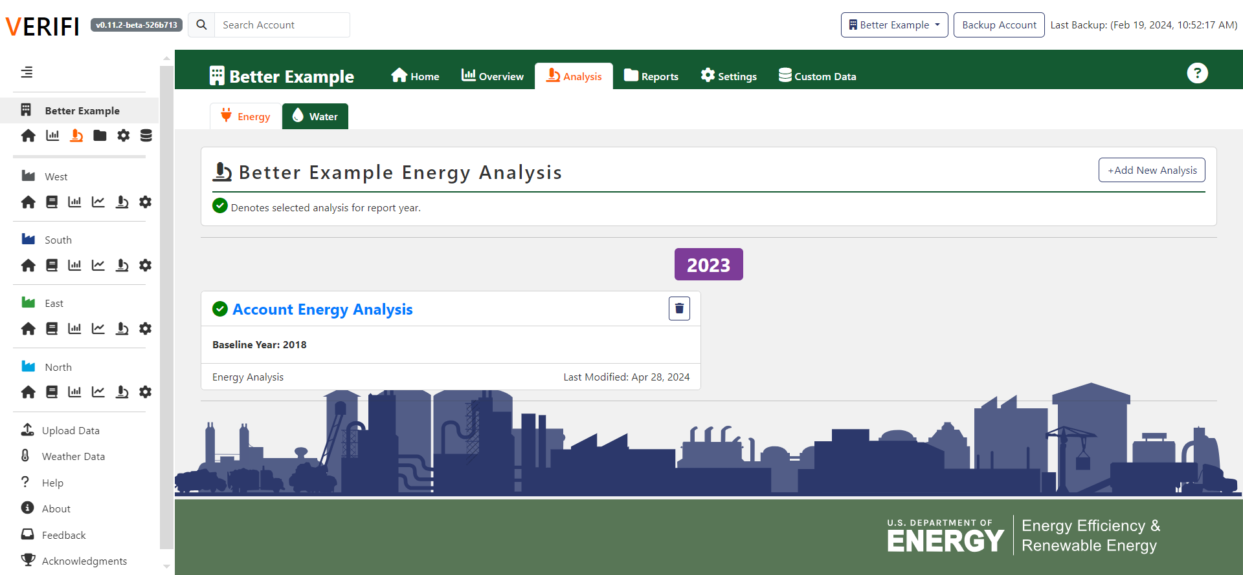
Completing a Company-Level Analysis
Start a Company-level analysis
Set baseline and reporting years for the analysis
Select which facility-level analyses to include
View the results!
1
2
3
4

Slide 33
Making Company-Level Reports
Reports are aggregates of analysis results for concise viewing
VERIFI can make:
Better Plants Reports
Better Climate Challenge Reports
Better Plants Water Reports
Energy Performance Reports
Data Overview Reports
Select a company-level analysis to make an automated report

Slide 34
Other DOE Software Tools
Helpful software tools developed for the industrial sector.

Slide 35
Other DOE Software Resources
System Level Analysis!
MEASUR
FREE, Open-source software suite to analyze energy saving opportunities for industrial equipment
Six assessment types: pumps, process heating, fans, steam, wastewater, and compressed air
Motor and pump inventories
Energy treasure hunt module
80 stand-alone calculators for simple calculations
Web, mobile, and desktop versions
Can be used internationally
Download at https://ornl-amo.github.io/
Visit https://measur.ornl.gov/ in your web browser
Type “ORNL MEASUR” in your web search

Slide 36
Other DOE Software Resources
Choose your Own Solution
Can you decarbonize this industrial facility?
Interactive game that highlights the challenges of reducing GHG emissions at a manufacturing facility
Play as an automotive industry decarbonization team
Goal is to reduce emissions by 50% within 10 years
Choose projects, watch your budget, overcome hurdles, find rebates, reduce emissions!
Play at https://cyos.ornl.gov/

Slide 37
Questions?

