Slide 1
How to Find and Begin using MEASUR: The Manufacturing Energy Assessment Software for Utility Reduction

Slide 2
DOE Industrial Software Tools
Designed to help energy and sustainability teams identify savings opportunities in their operational energy usage and emissions
Energy Systems
MEASUR
Electrification for Decarbonization
Compressed Air Scoping Tool
Energy Management
VERIFI
50001 Ready Navigator
Energy Footprint Tool
Plant Energy Profiler
Implementation Guidance Toolkit
Carbon, Water, & Waste
Plant Water Profiler
Plant Carbon Footprint & Decarbonization Assessment Tool
Carbon Emissions Calculator
Waste Stream Energy Content

Slide 3
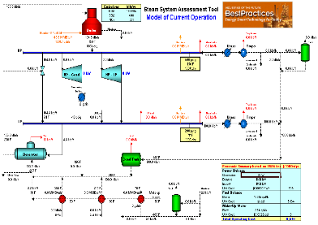
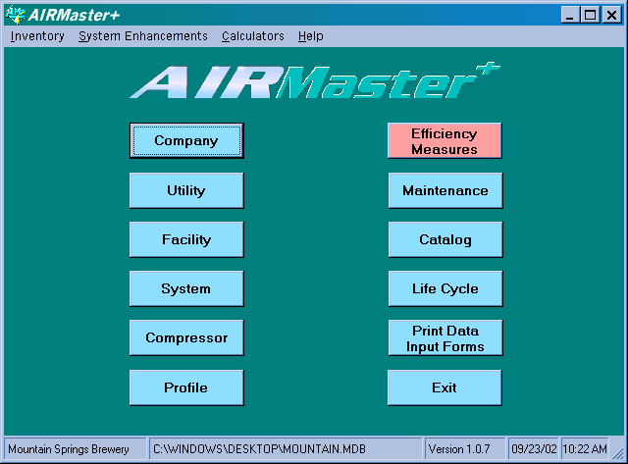
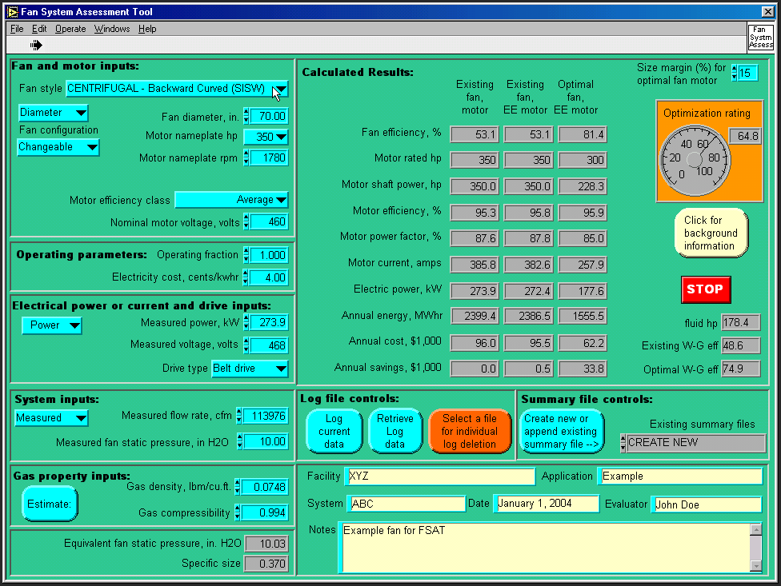
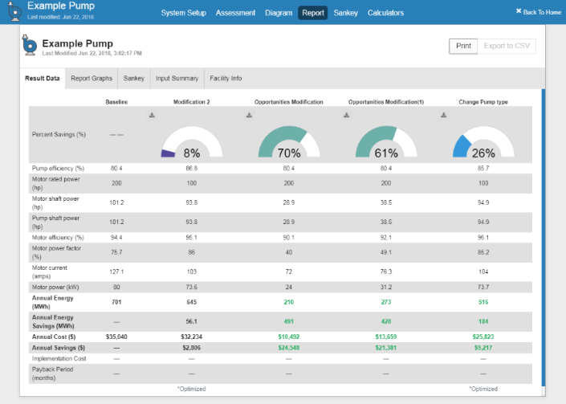
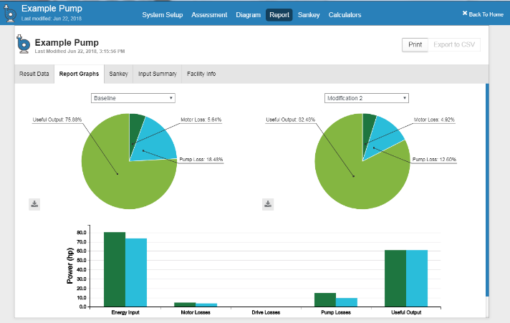
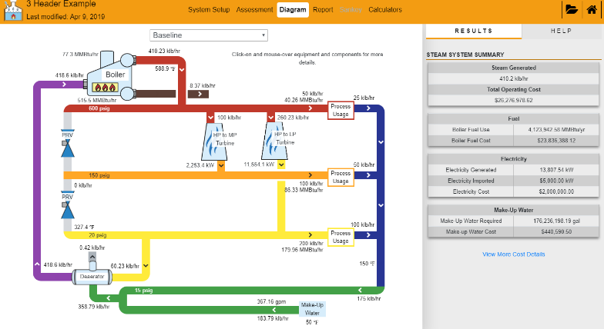
DOE Energy Efficiency Software
Technology and vendor agnostic tools to identify, quantify, and validate energy saving opportunities
Original DOE software tools developed in the 1990’s in collaboration with industry experts
Modernize to Open-Source Software
Single Free, Open-Source, OS Agnostic Tool
Upgraded tool capabilities
Government-side open-source software UT-Battelle Permissive License: “Do whatever, but please provide attribution.”
Desktop/Web/Mobile
Automatic update notification
Enable Technology Field Validation

Slide 4
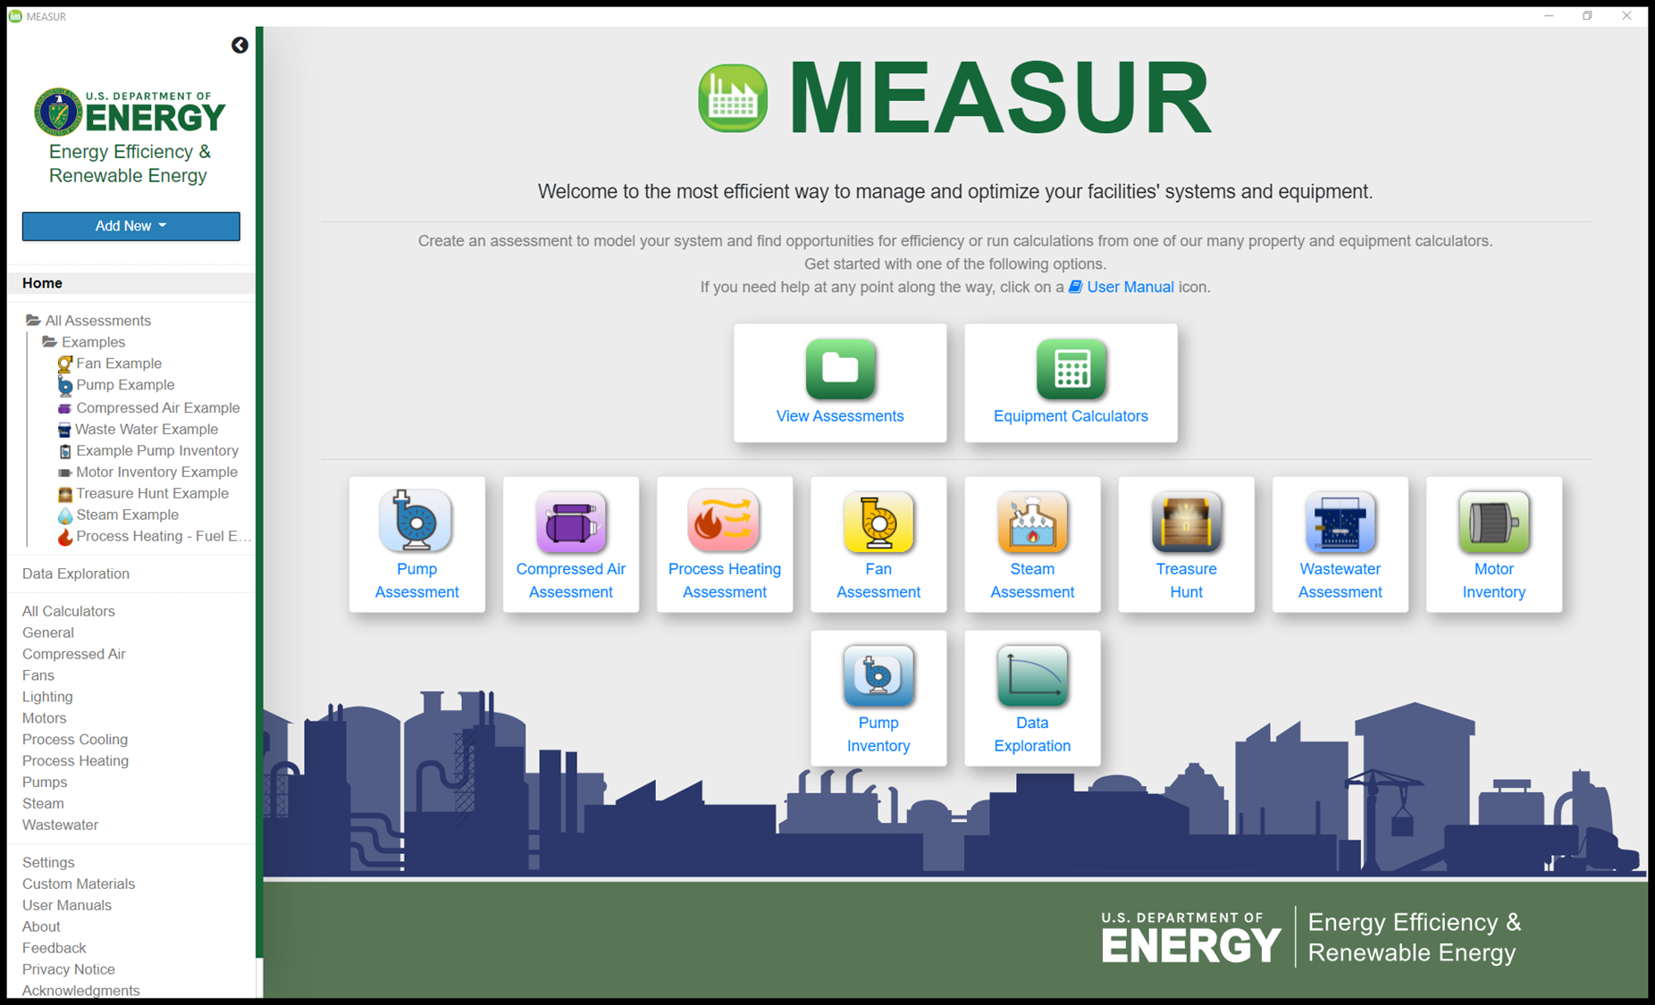
MEASUR is an Integrated Energy Tool
Free to Use
OS Agnostic
Desktop: Web & App - Windows, Mac, Linux
Mobile: Web & App – Android & iPhone
International Useability
No limits on where they can be downloaded or accessed
Google Translate available for web version
Unit system flexibility: Make an assessment in metric or U.S. units and switch to the other
Data Privacy
Data is stored on *YOUR* device
No data you entered is sent to us unless you send it to us directly
Data related to use (where you click, etc.) is collected via Google Analytics to improve the tool
Automatic Updates

Slide 5
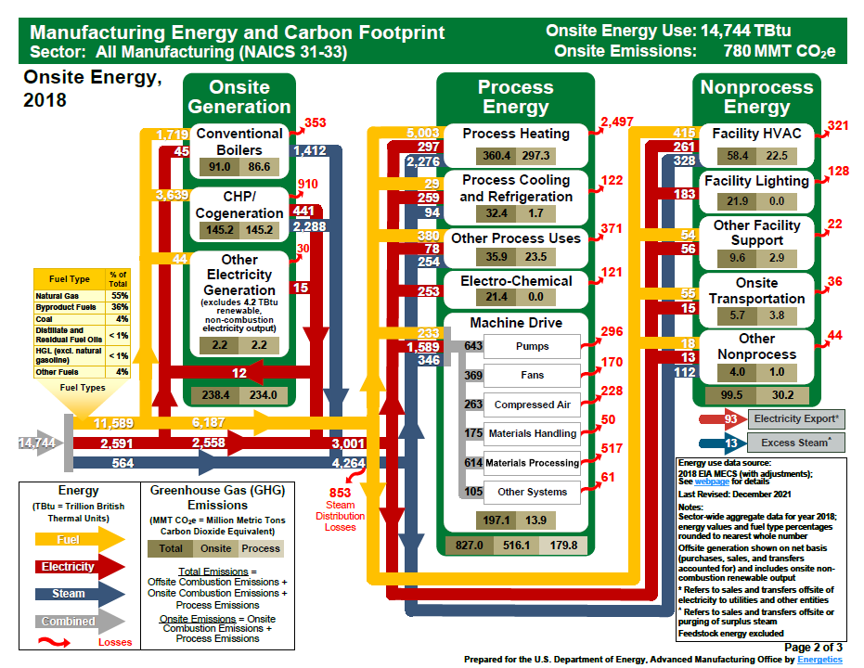
How MEASUR can Help Assessments
Model manufacturing energy use and generation
Quantify savings opportunities
Help reduce the losses in key manufacturing energy users ~4.48 QBTU (2018)
6 Assessment types, 2 Inventories, + Treasure Hunt
Pumps, process heating, fans, steam systems, and compressed air
Motor & Pump Inventories
Treasure Hunt with calcs for all systems
80 Stand alone Calculators
Pumps, fans, heating, compressed air, steam, motors, lighting, CHP, etc.

Slide 6
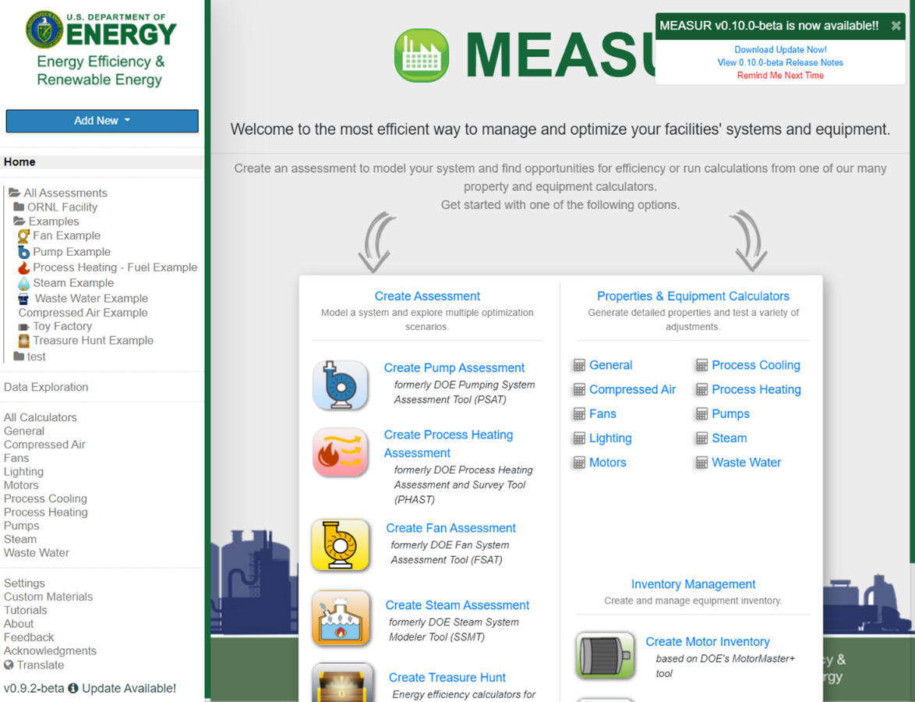
Finding MEASUR
Officially released March 2022
Updates will occur often
Automatic notification of updates if connected to the internet
Please report bugs to measur-help@ornl.gov
Download from DOE or GitHub
Uninstalling will delete your assessments!
If using online –
Clearing cache will delete your assessments!
Download here:
https://www.energy.gov/eere/iedo/measur
https://ornl-amo.github.io/
Or Google “MEASUR”
Web version: https://measur.ornl.gov/

Slide 7
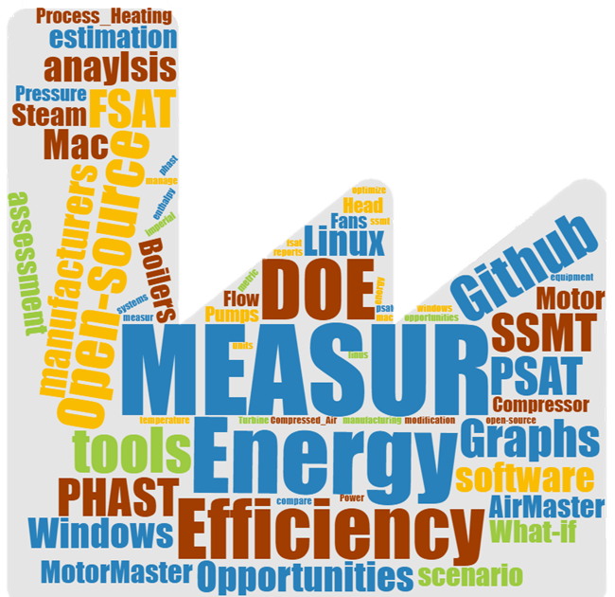
MEASUR Demo
Using MEASUR

Slide 8
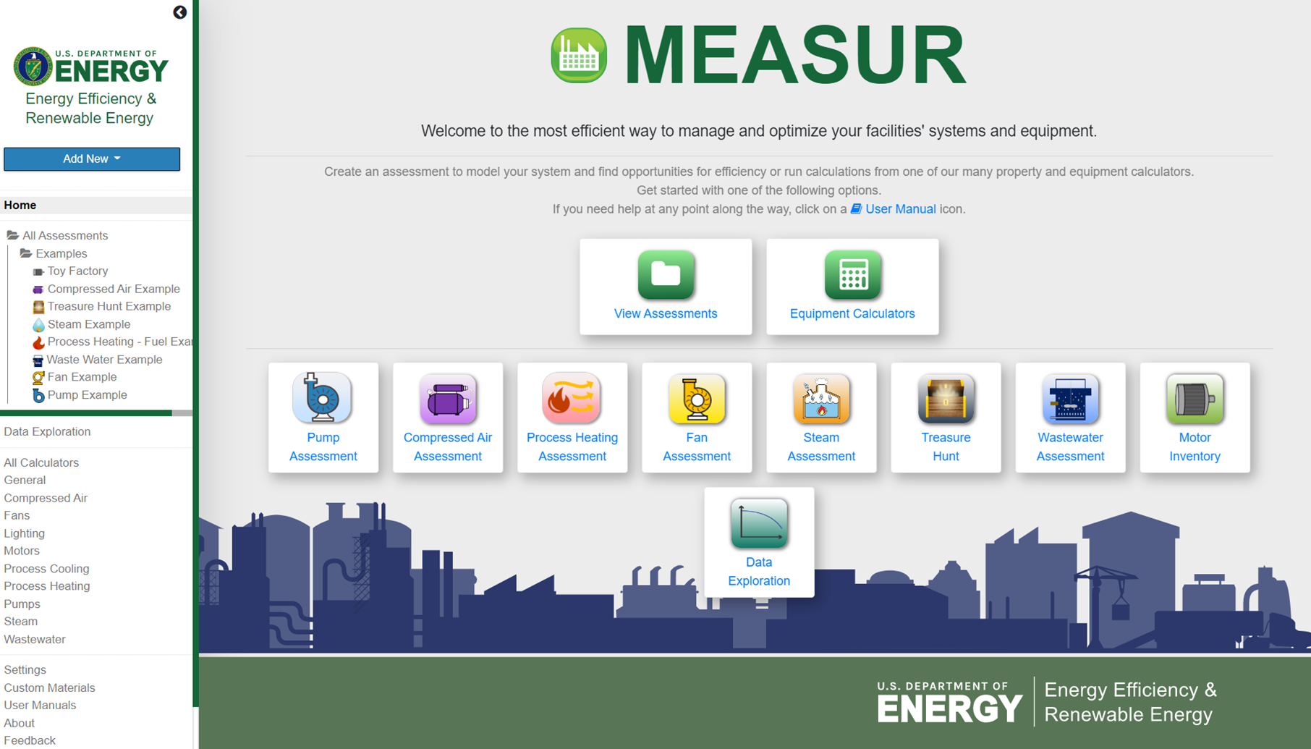
Getting Started
Start an assessment
Create an inventory
View Assessment Dashboard
Use Properties & Equipment Calculators
Help and User Experience
Change Settings
View Tutorials
Manage Custom Materials
Provide Feedback
Translate

Slide 9
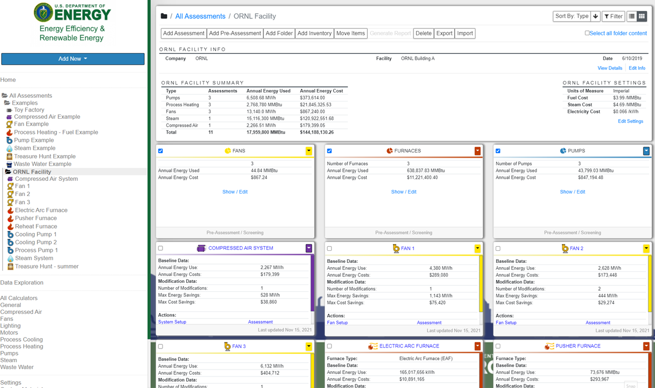
Dashboard – Assessments organized in folder structure
Folders can represent Facilities or Departments
Move, copy, import and export assessments
Add/view facility information and folder-wide settings
Make pre-assessment screenings
Generate rollup reports of several assessments
Add New Assessment
Add New Inventory

Slide 10
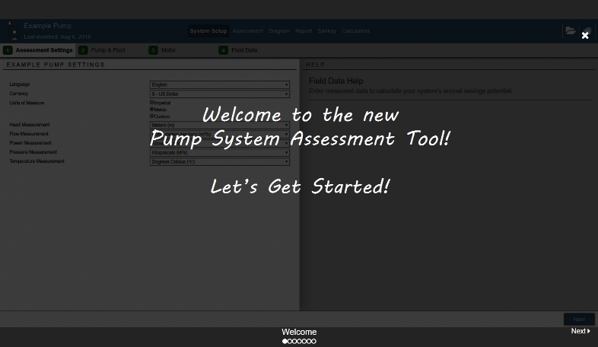
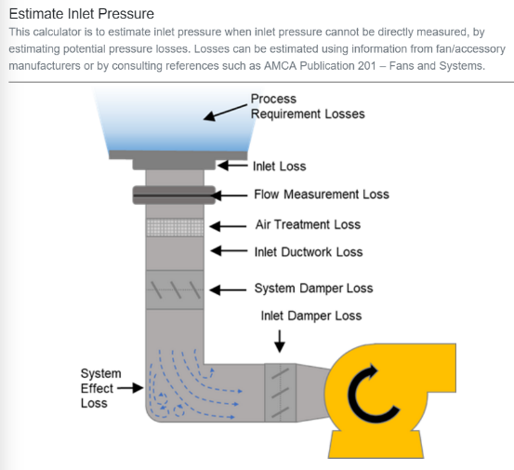
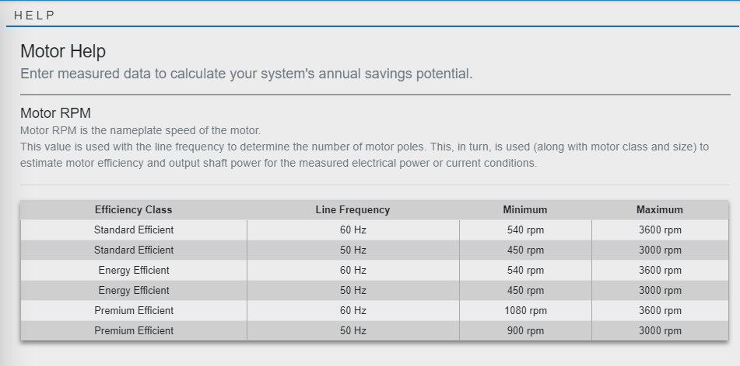
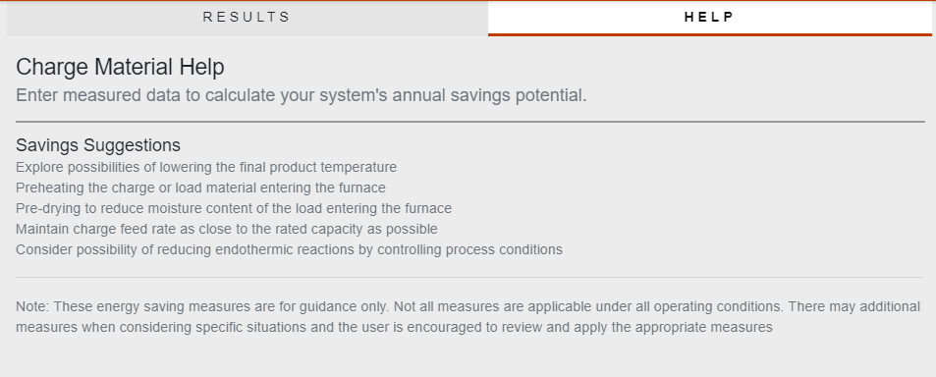
MEASUR includes Help Text & Tutorials
Tutorials
Help to get started using tool
Help text for each data entry field
Diagrams to help understand where to obtain data
Can switch between help or results being shown by default

Slide 11
Customize Units
Units are easily customizable and can be changed after data entry!
Can be changed globally in Settings or for a folder

Slide 12
Start an Assessment from the home page or dashboard
Choose a unique name for the assessment
Set Assessment type (Pump, Compressed Air, Fan, Process Heater, Steam, Treasure Hunt, Wastewater)
Choose folder location
Or make a new folder
Several places to start an assessment

Slide 13
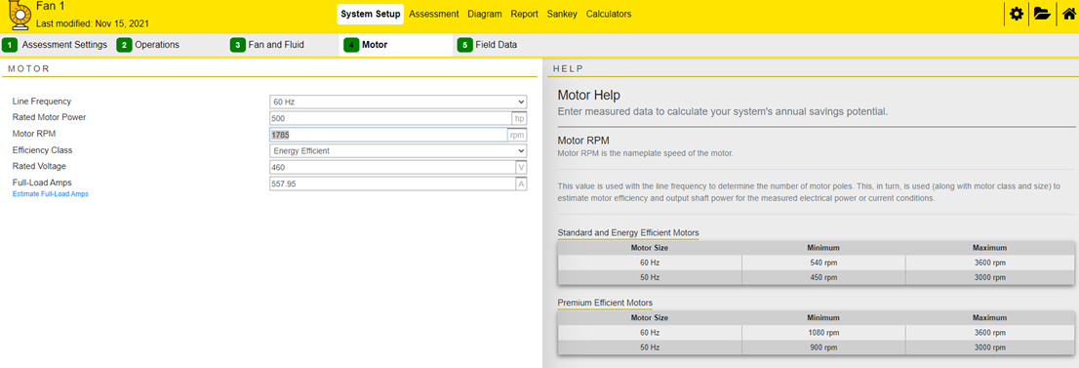
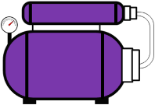
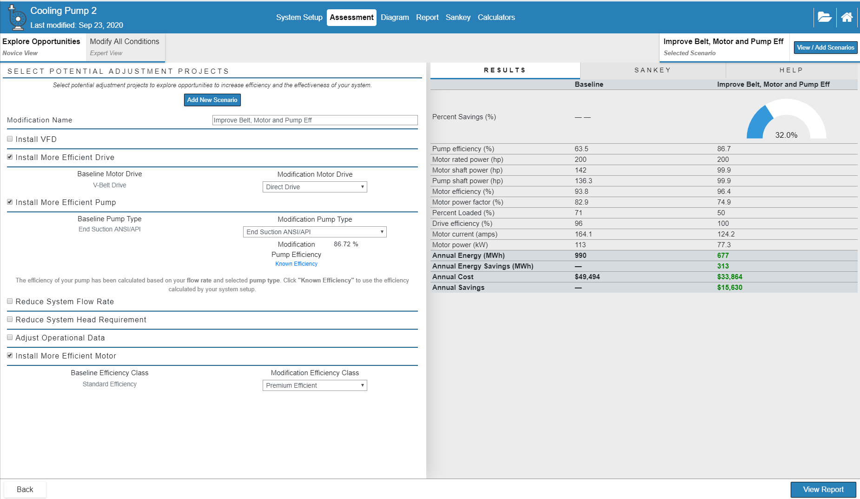
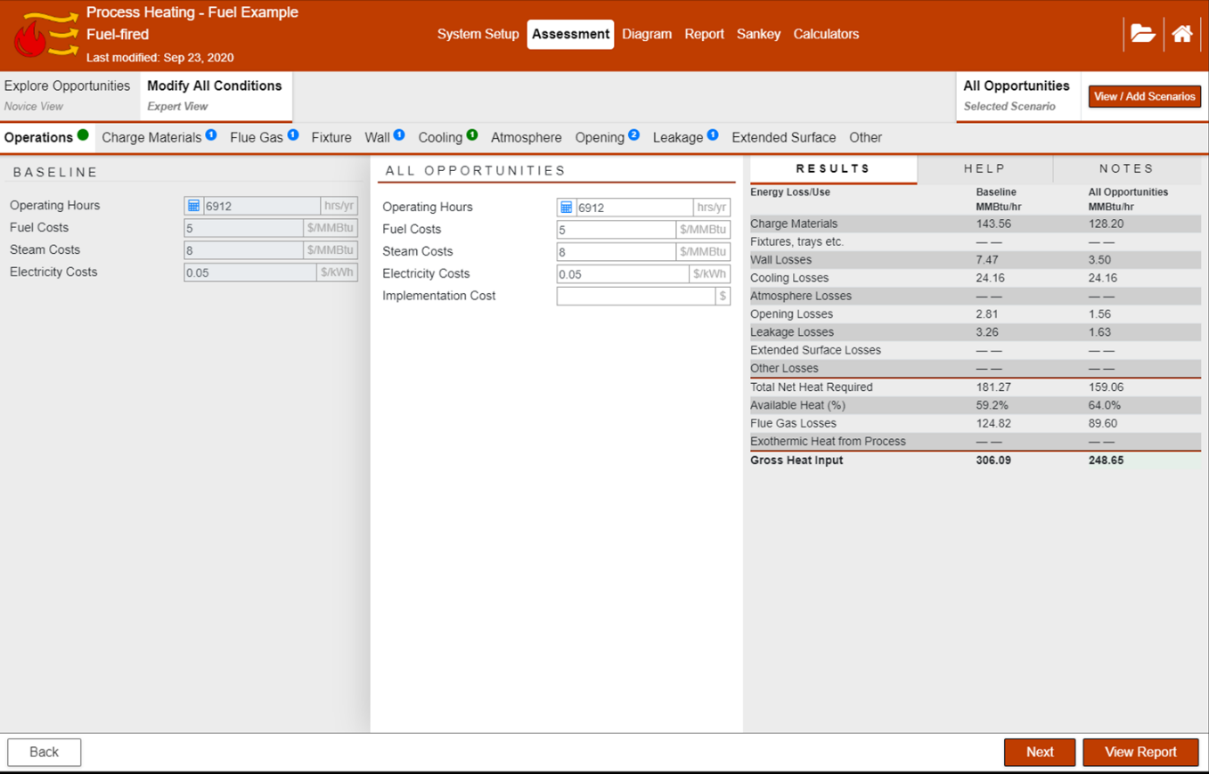
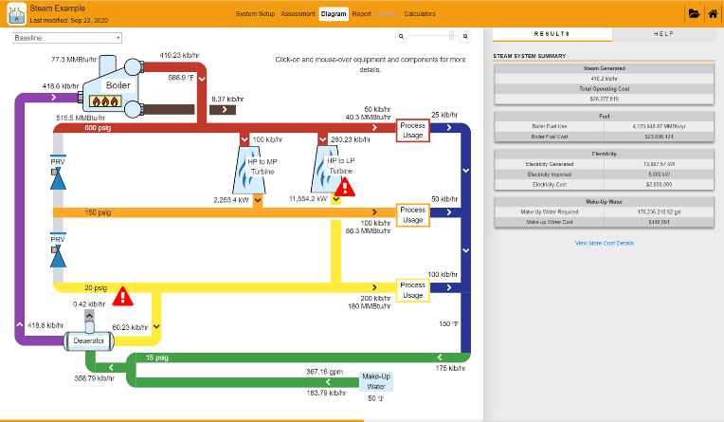
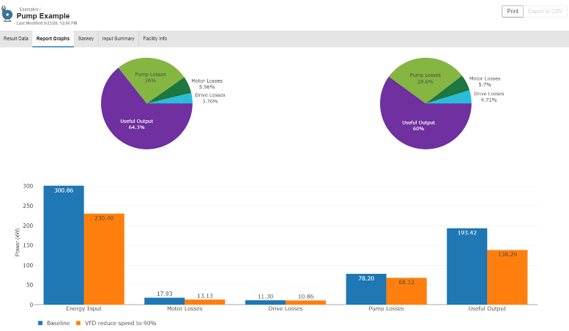
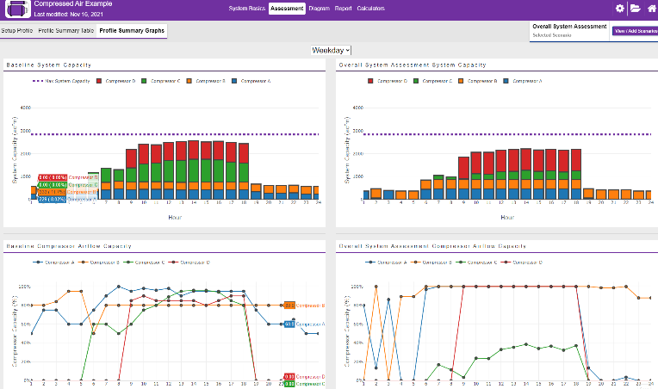
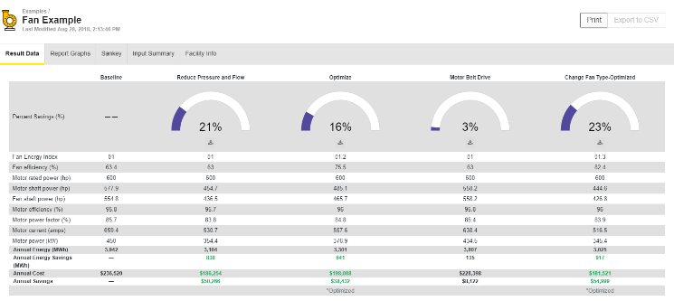
Assessments all have similar workflow
Create a baseline
Enter data about current system setup
Create an assessment
Modify key variables to create What-if scenarios and compare
Review Results

Slide 14
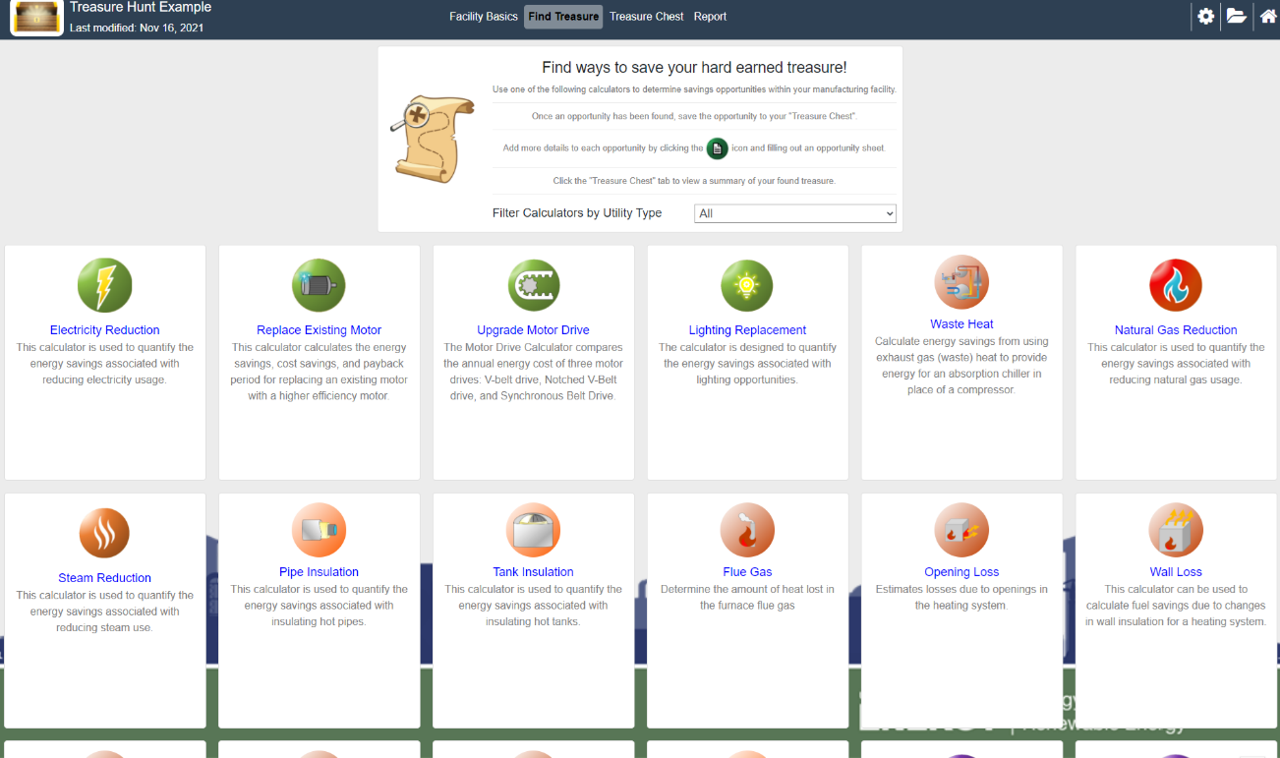
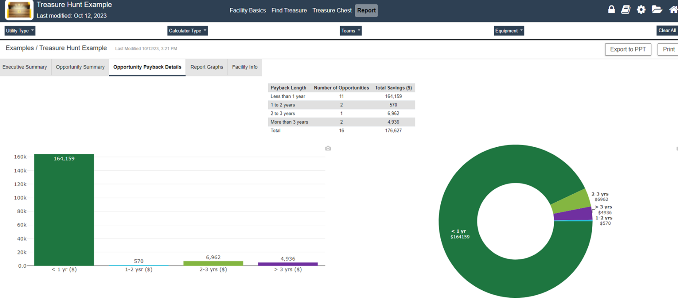
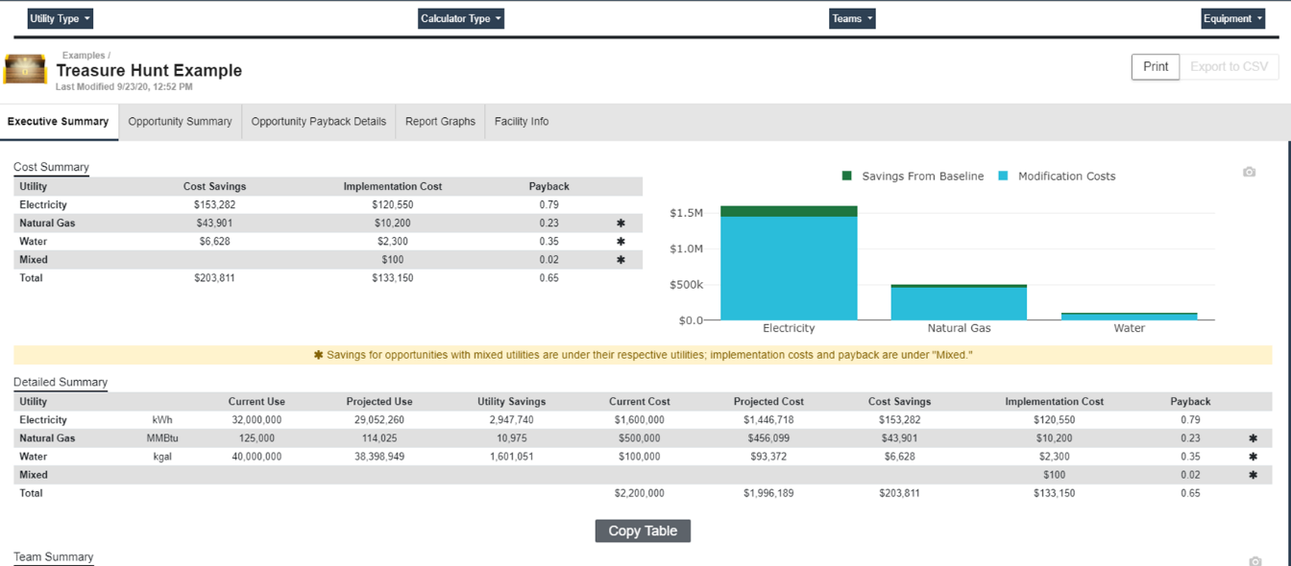
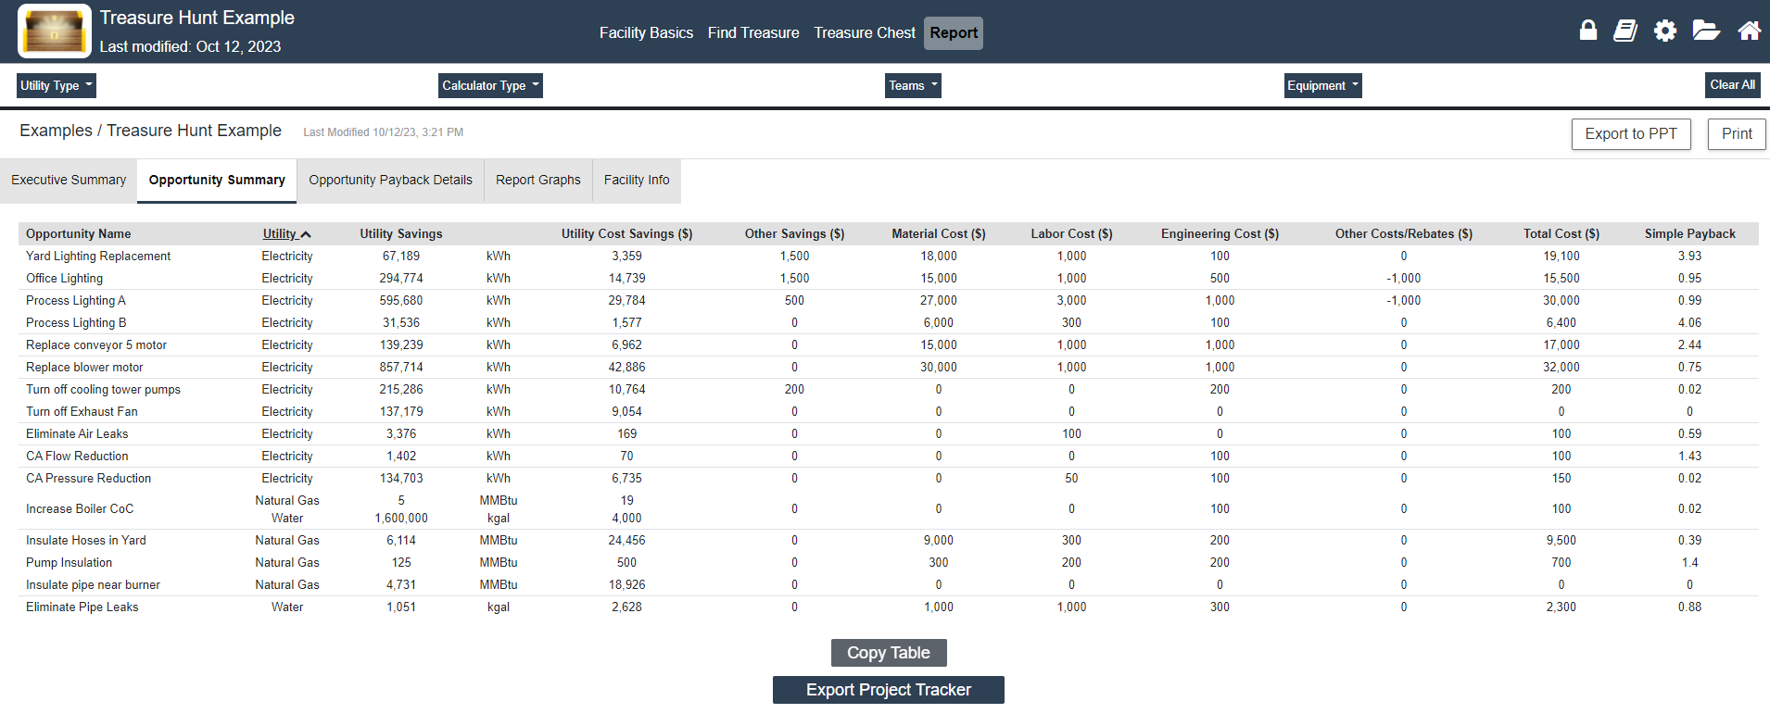
Treasure Hunt helps find low/no cost opportunities
Find low/no cost energy savings opportunities in motor systems, process heating, compressed air, lighting, etc.
Simplify report out with automatically built PowerPoint presentation
Get started right with automatically built Project Tracker (Excel)

Slide 15
Simple, easy-to-use Calculators
80 Stand alone Calculators
Motors
Pumps
Fans
Process Heating
Process Cooling
Steam
Compressed Air
Lighting
General
Most have graphical results

Slide 16
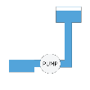
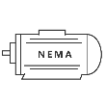
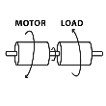
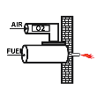
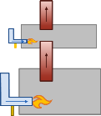
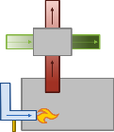
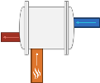
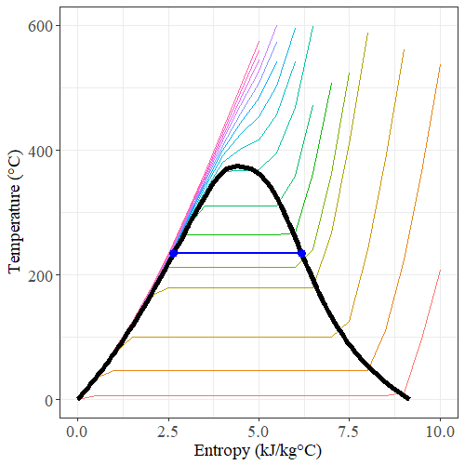
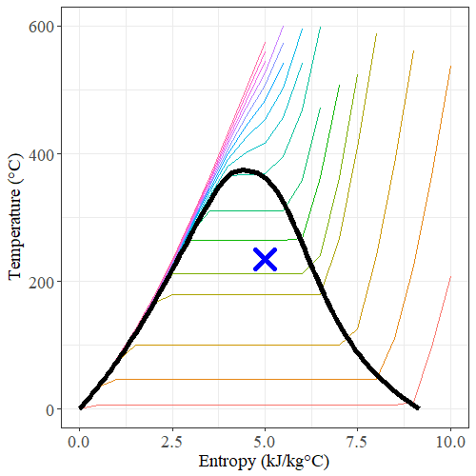
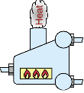
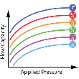
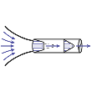
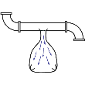
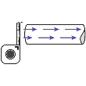
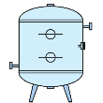
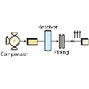
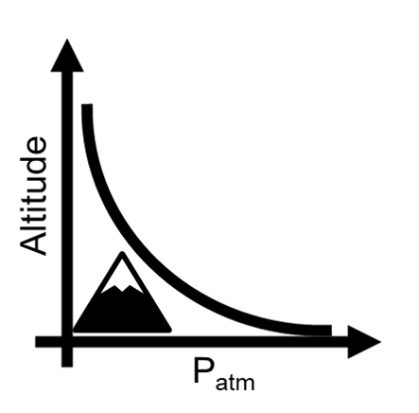
Simple, easy-to-use Calculators
80 Stand alone Calculators
Motors
Pumps
Fans
Process Heating
Process Cooling
Steam
Compressed Air
Lighting
General
Most have graphical results

Slide 17
Things to remember
MEASUR is great for good estimations, but
Quality of results depends on the quality of data!
Better baseline data, more accurate results
More realistic modifications, more accurate results
Keep in mind when pitching projects

Slide 18
Starting an Assessment
Choose a unique name for the assessment
Set Assessment type (Pump, Compressed Air, Fan, Process Heater, Steam, Treasure Hunt, Wastewater)
Choose folder location
Or make a new folder

Slide 19
Each System Setup starts with Assessment Settings
Decide settings for Assessment
Units: Imperial or Metric
Can set Energy Results separately
Select energy source for furnace
Cannot be changed if there are losses in Heat Balance
Add notes on conditions at time of assessment

Slide 20
System Setup
Start with current equipment and operations - Baseline
Assessment Settings: Set units and basic assessment settings
Assessment Specific Tabs
Data Entry for baseline assessment
Intermediate Results
Help text for each data entry field

Slide 21
Assessments
Explore energy savings opportunities
Explore Opportunities: build scenarios from pre-established energy savings measures
Modify All Conditions: build scenarios using same forms as baseline
Badges and field highlighting for visual cues

Slide 22
Reports
View side-by-side comparison of all scenarios and graphs for data visualization

Slide 23
Reports - Printing
Print to PDF for Assessment Reports & Rollup Reports

Slide 24
MEASUR’s Modules
Pumps
Process Heating
Fans
Steam
Compressed Air
Wastewater
Treasure Hunt
Data Explorer
Inventories (Motors & Pumps)

Slide 25
Pumps
Estimate motor full load amps, load current and power factor, fluid head, and fan and motor efficiency
Explore the savings from changing pump and motor efficiency (which can be optimized automatically), flow and head, or even fluid temperature

Slide 26
Process Heating
Calculate heat losses from several heater components
Explore the savings from reducing flue gas oxygen or temperature, preheating air or charge materials, controlling furnace pressure, closing openings, etc.

Slide 27
Fans
Estimate motor full load amps, load current and power factor, pressure and flow from a traverse analysis, and fan and motor efficiency
Explore the savings from changing fan and motor efficiency (which can be optimized automatically), flow and pressure, or even fluid characteristics

Slide 28
Steam
Determine steam flows, fuel use, electricity production throughout system
Explore the savings from adding/removing turbines, adding flash tanks, increasing condensate recycle, etc.

Slide 29
Compressed Air
Develop a compressed air inventory and understand average hourly operations, performance and impact on energy use
Explore the savings from reducing leaks, air demand, or system pressure, improve controls, etc.

Slide 30
Wastewater
Determine sludge production, O₂ supply and demand, MLSS or SRT, and aerator energy use
Explore the savings from optimizing SRT, reducing DO concentration, matching oxygen supply and demand, optimizing aerator performance, etc.

Slide 31
Treasure Hunt
Find low/no cost energy savings opportunities in motor systems, process heating, compressed air, lighting, etc.
Simplify report out with automatically built PowerPoint presentation
Get started right with automatically built Project Tracker (Excel)

Slide 32
Data Explorer
Two Key Functions
Day Type Analysis
Used for finding hourly averages for similar load profiles
For Compressed Air Assessment and other long-term analyses
Based on LogTool
Data Visualization – easy graphing capabilities to explore large datasets

Slide 33
Equipment Inventories
Modeled after MotorMaster
Record key information about equipment in one place
Motors – Beta
Pumps, fans, compressors, maintenance - Planning
Sort & filter, summary graphs, inventory printouts
Batch analysis for simple calculators

Slide 34
Backup & Feedback
Easily backup entire MEASUR data
If using downloaded version, can setup Automatic Backup
Let us know if you like MEASUR!
Built in survey!
Bug Reporting
Email: measur-help@ornl.gov
Screenshots please

Slide 35
Settings
Set global units & utility costs
Turn on/off Tutorials
Clear Data

Slide 36
Dashboard – Set Facility Information
The Dashboard is designed to treat each folder like a facility or business unit
Enter information about facility. This will appear in reports
Quick Summary of all assessments in folder
Set units and utility costs for any NEW assessments created

Slide 37
Dashboard - Pre-Assessments
Pre-Assessments are to help you triage equipment to best utilize assessment time
Enter either design specifications or meter data to determine your priorities
Graphed to quickly see most impactful
Switch between Energy Use and Cost if equipment uses different fuel

Slide 38
Dashboard - Rollup Reports
Create Rollup Reports to see the impacts of opportunities on overall energy use
Choose which assessments & pre-assessments to include in rollup
Review all reports
Then Click
View Equipment Summary
Choose which scenario to include

Slide 39
Example Calculators
CO₂ Savings
Pump Curve
Saturated Properties
O₂ Enrichment
Compressed Air Leak Survey
Motor Performance

Slide 40
Custom Materials for fuels, charge materials, etc.
Add Fuels, Charge Materials, etc. that are not in MEASUR’s databases to reuse later
Can import & import custom materials

Slide 41
About & Acknowledgements
About
Intended Users
Inputs/Outputs for each modules
Acknowledgements
The end credits

Slide 42
Release Notes
Gives brief overview of what has been added since last update
Can also look at before installing update

Slide 43
Coming Soon
Water Diagram & Balance
Process Cooling
More Equipment Databases
Modeled after MotorMaster+ Database
Keep inventory of equipment (pumps, fans, compressors, etc.) connected to assessments

Slide 44
Acknowledgements
Subject Matter Experts
Don Casada, Diagnostic Solutions, LLC, developed the original PSAT and FSAT, and contributed the algorithms for the Pumping and Fan modules.
Arvind Thekdi, E3M, Inc. developed the original PHAST and continued to contribute to the Process Heating module by providing the algorithms for the previous versions (PHAST 3.0 and PHASTEx), updating the algorithms for improved accuracy, and providing feedback.
Vern Martin, Donovan Martin, and Mats Falk, Flowcare, provided updated Fan algorithms and feedback during the development of the Fan module.
Ron Wroblewski, Productive Energy Solutions, reviewed and provided updated Fan algorithms for the Fan module.
Greg Harrell, Milligan University, developed the previous versions of DOE steam tools and continued to contribute to MEASUR by providing feedback.
Glenn Cunningham, Tennessee Technical University, reviewed and provided feedback for the Pump, Fan, and Steam modules, as well as many calculators.
Riyaz Papar, Hudson Tech., reviewed and provided feedback for the Steam module.
Walt Brockway, reviewed and provided feedback for the Treasure Hunt module.
Larry Moore, University of Memphis, developed the original Bio-Tiger model for Wastewater Treatment facilities, oversaw updates to the algorithm, and provided feedback during the development of the Wastewater module.
Frank Moskowitz, Draw Professional Services, reviewed and provided feedback for the Compressed Air module.
Eric Bessey, TTed Solutions, Inc, developed and provided updated algorithms from the originals AirMaster+ software , provided feedback during the current algorithm development
Eric J. Wahlberg, Wastewater Technology Trainers, reviewed and provided feedback for the Wastewater module and calculators.
ORNL Staff
SULI, CCI, URSI Participants
Kyle Beanblossom Kai Chen
Autumn Ferree Zach Fontenot
Allie Ledbetter
Jordan Lees
Charlotte Merchant
Ben Rappoport Raul Rios
Shiva Saravanan
Andrew Worley
Gina Accawi
Kristina Armstrong
Mark Root
Thomas Wenning
Alexandra Botts
Ahmad Abbas
Omer Aziz
Subodh Chaudhari
Kita Cranfill Daryl Cox Wei Guo
Chris Price Sachin Nimbalkar
Senthil Sundaramoorthy
Kiran Thirumaran
Contractors and ORAU Student Employees
Nick Blondheim
Rachel Stone
Colin Causey
Jeff Jensen
Jon Hadden Dmitry Howard Michal Kaminski
Shubham Kokul
Subhankar Mishra Asha Shibu Preston Shires David Vance Michael Whitmer

Slide 45
Feedback or bugs? Email: armstrongko@ornl.gov accawigk@ornl.gov wenningtj@ornl.gov

